Slide 1
ns-3 Training
ns-3 Annual Meeting
June 2016

Slide 2
Software overview
ns-3 is written in C++, with bindings available for Python
simulation programs are C++ executables or Python programs
~350,000 lines of C++ (cloc estimate)
almost exclusively C++98, beginning to use C++11
ns-3 is a GNU GPLv2-licensed project
ns-3 is mainly supported for Linux, OS X, and FreeBSD
Windows Visual Studio port available
ns-3 is not backwards-compatible with ns-2

Slide 3
Discrete-event simulation basics
Simulation time moves in discrete jumps from event to event
C++ functions schedule events to occur at specific simulation times
A simulation scheduler orders the event execution
Simulation::Run() executes a single-threaded event list
Simulation stops at specific time or when events end
Execute a function
(may generate additional events)
Virtual time
Advance the virtual time
to the next event (function)

Slide 4
The basic ns-3 architecture
Application
Application
Application
Application
Sockets-like
API
Protocol
stack
Protocol
stack
Packet(s)‏
Node
Node
NetDevice
NetDevice
NetDevice
Channel
NetDevice
Channel

Slide 5
Software orientation
Key differences from other network simulators:
1) Command-line, Unix orientation
vs. Integrated Development Environment (IDE)
2) Simulations and models written directly in C++ and Python
vs. a domain-specific simulation language

Slide 6
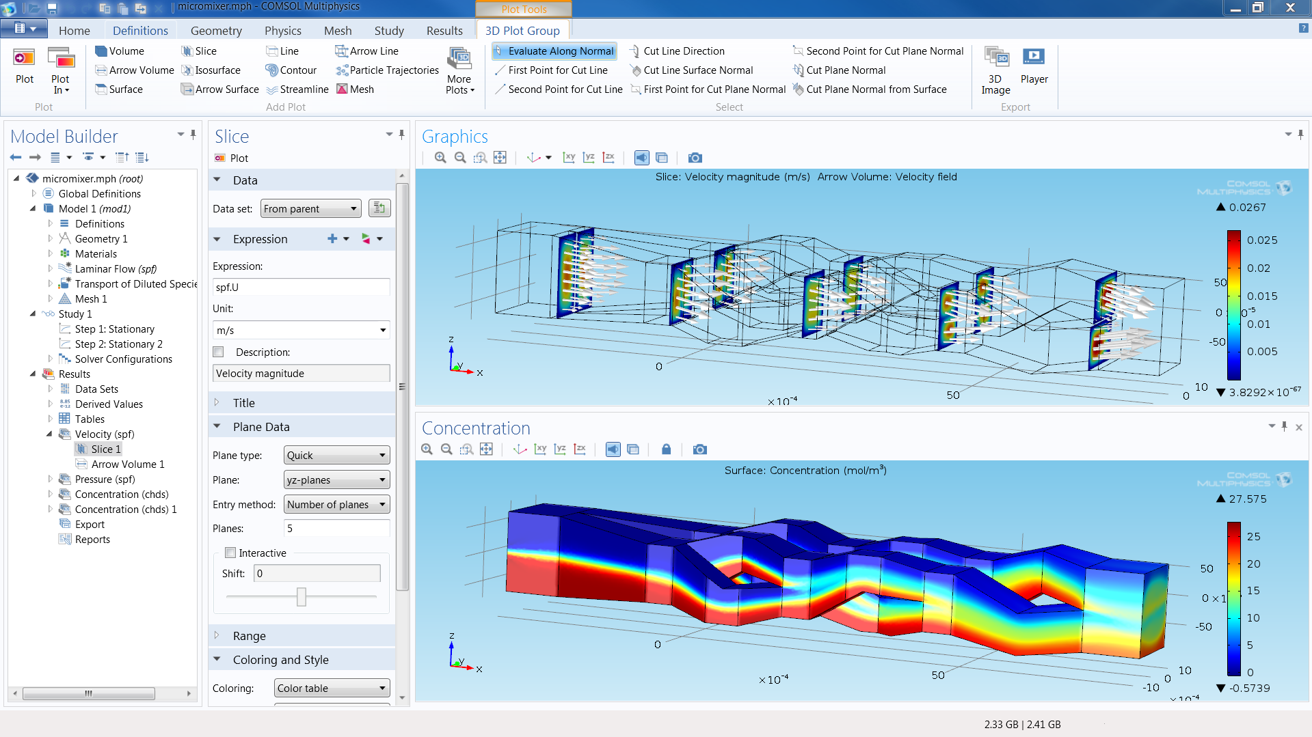
ns-3 does not have a graphical IDE
Figure source: https://www.comsol.com/comsol-multiphysics

Slide 7
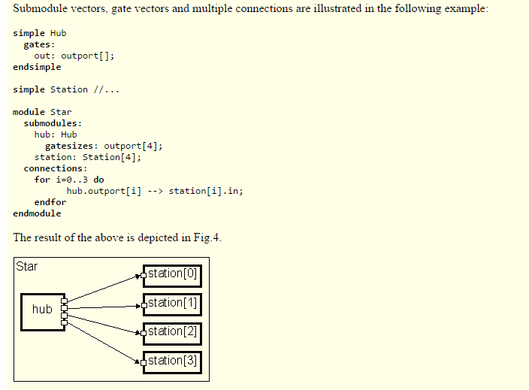
ns-3 not written in a high-level language
Example of OMNeT++ Network Description (NED) language
Figure excerpted from http://www.ewh.ieee.org/soc/es/Nov1999/18/ned.htm

Slide 8
Software organization
Two levels of ns-3 software and libraries
1) Several supporting libraries, not system-installed, can be in parallel to ns-3
Netanim
pybindgen
Click routing
ns-3
2) ns-3 modules exist
within the ns-3 directory
module
module
module
module
module
module

Slide 9
Current models
utilities
devices
protocols
visualizer
bridge
mesh
config-
store
applications
internet-apps
aodv
Node class
NetDevice ABC
Address types
(Ipv4, MAC, etc.)
Queues
Socket ABC
Ipv4 ABCs
Packet sockets
csma
spectrum
internet
(IPv4/v6)
dsdv
flow-monitor
energy
emu
Packets
Packet Tags
Packet Headers
Pcap/ascii file writing
tap-bridge
traffic-control
olsr
netanim
mpi
point-to-
point
uan
click
stats
Smart pointers
Dynamic types
Attributes
Callbacks
Tracing
Logging
Random Variables
mobility
virtual-
net-device
network
nix-vector-
routing
topology-
read
lte
Events
Scheduler
Time arithmetic
propagation
lr-wpan
wifi
core
openflow
BRITE
wimax
9

Slide 10
Module organization
models/
examples/
tests/
bindings/
doc/
wscript

Slide 11
ns-3 programs
ns-3 programs are C++ executables that link the needed shared libraries
or Python programs that import the needed modules
The ns-3 build tool, called 'waf', can be used to run programs
waf will place headers, object files, libraries, and executables in a 'build' directory

Slide 12
Python bindings
ns-3 uses a program called PyBindGen to generate Python bindings for all libraries
v
v
v
v
C++
header
Intermediate
Python
program
C++
bindings
code
Python
module
(py)gccxml
PyBindGen
C++ compiler

Slide 13
Integrating other tools and libraries

Slide 14
Other libraries
more sophisticated scenarios and models typically leverage other libraries
ns-3 main distribution uses optional libraries (libxml2, gsl, mysql) but care is taken to avoid strict build dependencies
the 'bake' tool (described later) helps to manage library dependencies
users are free to write their own Makefiles or wscripts to do something special

Slide 15
Gnuplot
src/tools/gnuplot.{cc,h}
C++ wrapper around gnuplot
classes:
Gnuplot
GnuplotDataset
Gnuplot2dDataset, Gnuplot2dFunction
Gnuplot3dDataset, Gnuplot3dFunction

Slide 16
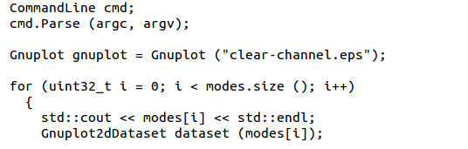
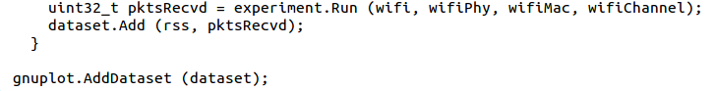
Enabling gnuplot for your code
examples/wireless/wifi-clear-channel-cmu.cc
produce a plot file that
will generate an EPS figure
one dataset per mode
Add data to dataset
Add dataset to plot

Slide 17
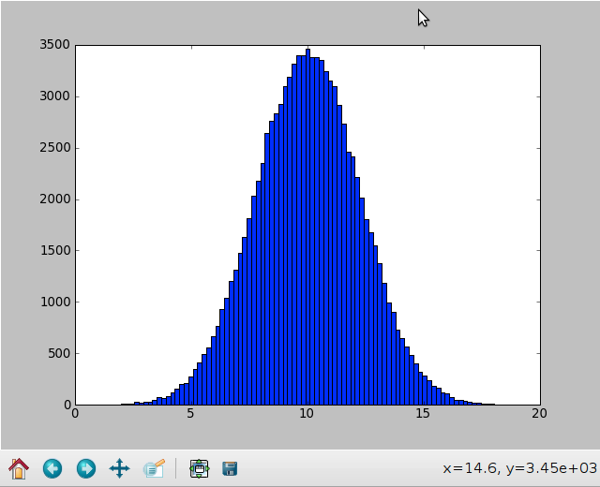
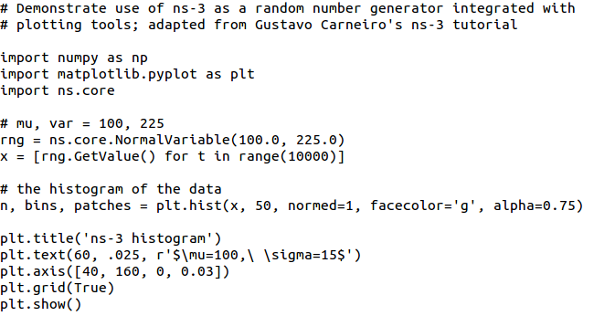
Matplotlib
src/core/examples/sample-rng-plot.py

Slide 18
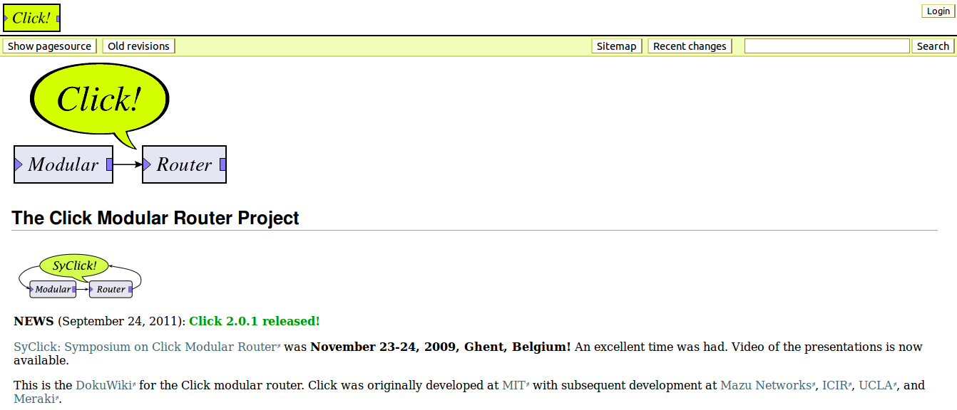
Click Modular Router

Slide 19
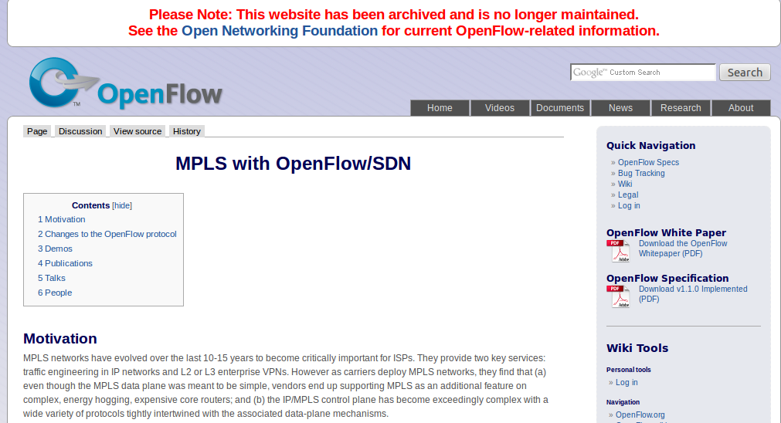
OpenFlow Switch

Slide 20
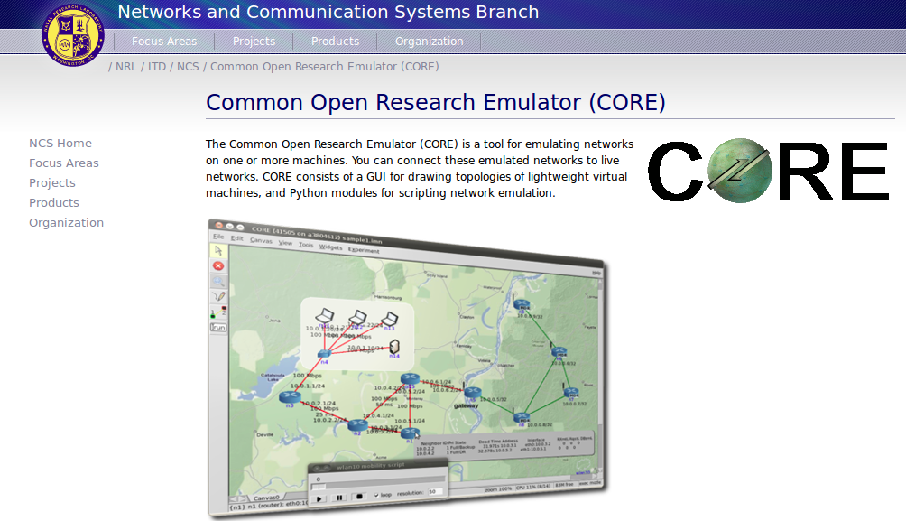
CORE emulator

Slide 21
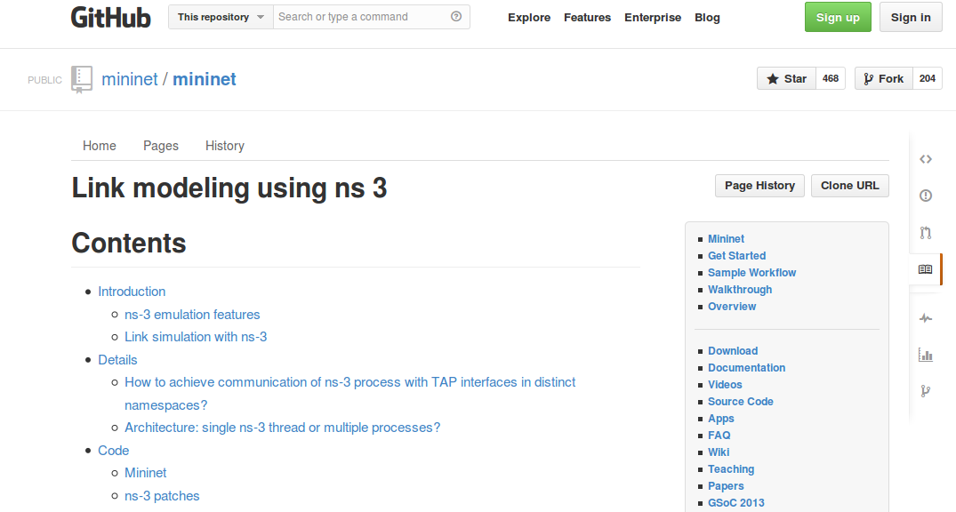
mininet emulator

Slide 22
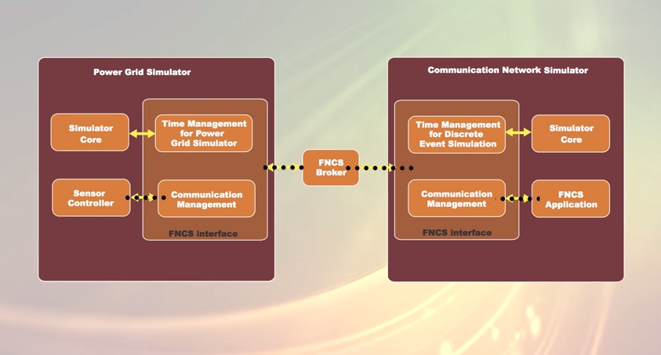
Co-simulation frameworks have emerged
PNNL's FNCS framework integrates ns-3 with transmission and distribution simulators
Image source: PNNLgov YouTube video:
Introducing FNCS: Framework for Network Co-Simulation

Slide 23
FAQs
Does ns-3 have a Windows version?
Yes, for Visual Studio 2012
http://www.nsnam.org/wiki/Ns-3_on_Visual_Studio_2012
Does ns-3 support Eclipse or other IDEs?
Instructions have been contributed by users
http://www.nsnam.org/wiki/HOWTO_configure_Eclipse_with_ns-3
Is ns-3 provided in Linux or OS X package systems (e.g. Debian packages)?
Not officially, but some package maintainers exist
Does ns-3 support NRL protolib applications?
Not yet

Slide 24
Summarizing
ns-3 models are written in C++ and compiled into libraries
Python bindings are optionally created
ns-3 programs are C++ executables or Python programs that call the ns-3 public API and can call other libraries
ns-3 is oriented towards the command-line
ns-3 uses no domain specific language
ns-3 is not compatible with ns-2

Slide 25
Finding documentation and code

Slide 26
Resources
Web site:
http://www.nsnam.org
Mailing lists:
https://groups.google.com/forum/#!forum/ns-3-users
http://mailman.isi.edu/mailman/listinfo/ns-developers
Wiki:
http://www.nsnam.org/wiki/
Tutorial:
http://www.nsnam.org/docs/tutorial/tutorial.html
IRC: #ns-3 at freenode.net

Slide 27
Suggested steps
Work through the ns-3 tutorial
Browse the source code and other project documentation
manual, model library, Doxygen, wiki
ns-3 Consortium tutorials (May 2014)
https://www.nsnam.org/consortium/activities/training/
Ask on ns-3-users mailing list if you still have questions
We try to answer most questions

Slide 28
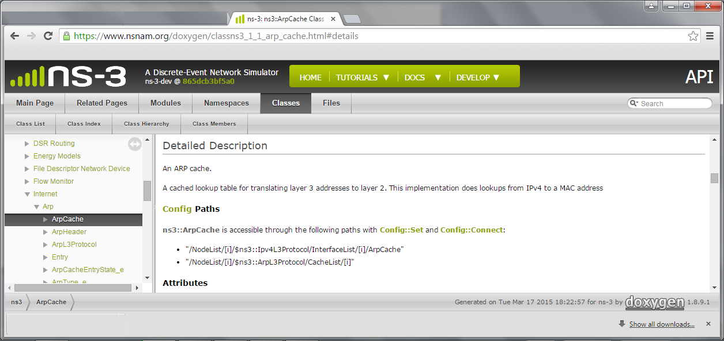
APIs
Most of the ns-3 API is documented with Doxygen
https://www.nsnam.org/doxygen

Slide 29
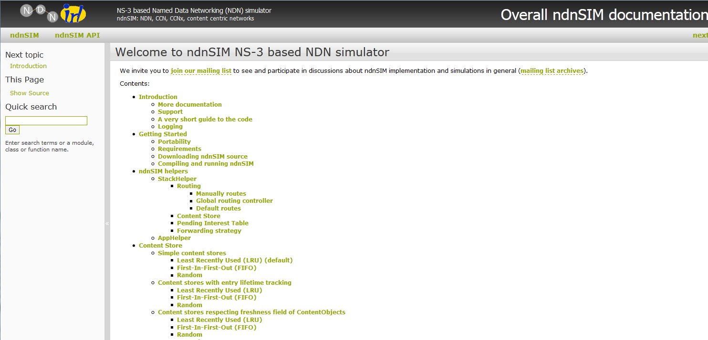
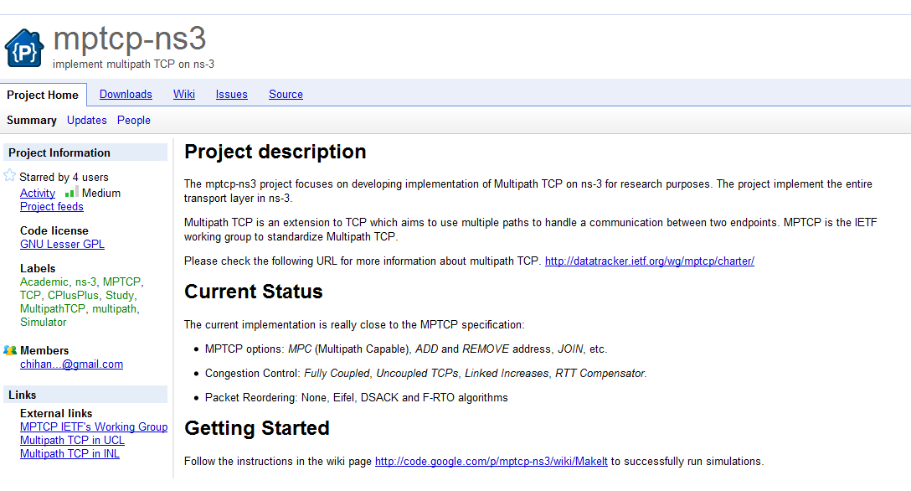
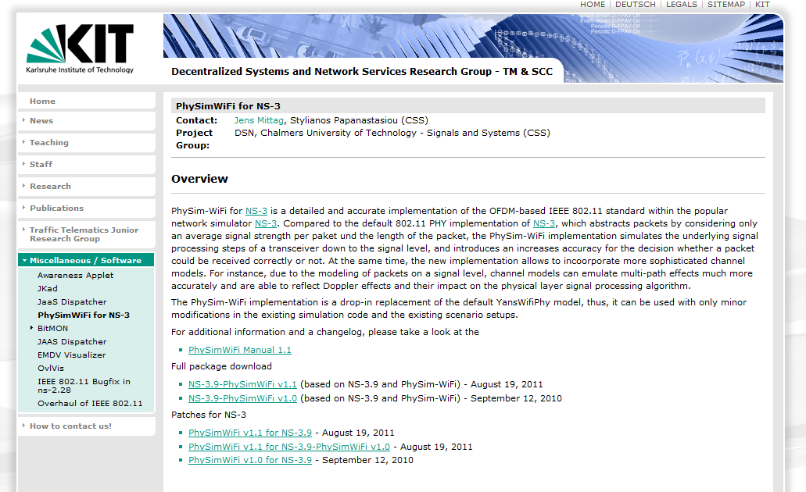
Contributed code and associated projects

Slide 30
Reading existing code
Much insight can be gained from reading ns-3 examples and tests, and running them yourselves
Several core features of ns-3 are only demonstrated in the core test suite (src/core/test)
Stepping through code with a debugger is informative
callbacks and templates make it more challenging than usual
'find src -name "*.h" | xargs grep "string..." '

Slide 31
Review
ns-3 primarily aims to support the networking researcher
ns-3 is C++ under GPLv2, with Python bindings
ns-3 is mainly designed for low-level coding, work at the command line, and composition with other tools
most users edit or extend the source code
ns-3 tries to operate according to open source project best current practices
everyone is a volunteer
search for what you need, ask questions when you get stuck, and think about contributing back to the project

Slide 32
ns-3 Waf build system
ns-3 Annual Meeting
June 2016

Slide 33
Software introduction
Download the latest release
wget http://www.nsnam.org/releases/ns-allinone-3.19.tar.bz2
tar xjf ns-allinone-3.19.tar.bz2
Clone the latest development code
hg clone http://code.nsnam.org/ns-3-allinone
Q. What is "hg clone"?
A. Mercurial (http://www.selenic.com) is our source code control tool.

Slide 34
Software building
Two levels of ns-3 build
1) bake (a Python-based build system to control an ordered build of
ns-3 and its libraries)
Network
Simulation
Cradle
pybindgen
click routing
ns-3
2) waf, a build system written in Python
module
module
module
module
module
module
3) build.py (a custom Python build script to control an ordered build of
ns-3 and its libraries) <--- may eventually be deprecated

Slide 35
ns-3 uses the 'waf' build system
Waf is a Python-based framework for configuring, compiling and installing applications.
It is a replacement for other tools such as Autotools, Scons, CMake or Ant
http://code.google.com/p/waf/
For those familiar with autotools:
configure ./waf configure
make ./waf build

Slide 36
waf configuration
Key waf configuration examples
./waf configure
--enable-examples
--enable-tests
--disable-python
--enable-modules
Whenever build scripts change, need to reconfigure
Demo: ./waf --help
./waf configure --enable-examples --enable-tests --enable-modules='core'
Look at: build/c4che/_cache.py

Slide 37
wscript example
## -*- Mode: python; py-indent-offset: 4; indent-tabs-mode: nil; coding: utf-8; -*-
def build(bld):
obj = bld.create_ns3_module('csma', ['network', 'applications'])
obj.source = [
'model/backoff.cc',
'model/csma-net-device.cc',
'model/csma-channel.cc',
'helper/csma-helper.cc',
]
headers = bld.new_task_gen(features=['ns3header'])
headers.module = 'csma'
headers.source = [
'model/backoff.h',
'model/csma-net-device.h',
'model/csma-channel.h',
'helper/csma-helper.h',
]
if bld.env['ENABLE_EXAMPLES']:
bld.add_subdirs('examples')
bld.ns3_python_bindings()

Slide 38
waf build
Once project is configured, can build via ./waf build or ./waf
waf will build in parallel on multiple cores
waf displays modules built at end of build
Demo: ./waf build
Look at: build/ libraries and executables

Slide 39
Running programs
./waf shell provides a special shell for running programs
Sets key environment variables
./waf --run sample-simulator
./waf --pyrun src/core/examples/sample-simulator.py

Slide 40
Build variations
Configuring a build type is done at waf configuration time
debug build (default): all asserts and debugging code enabled
./waf -d debug configure
optimized
./waf -d optimized configure
static libraries
./waf --enable-static configure

Slide 41
Controlling the modular build
One way to disable modules:
./waf configure --enable-modules='a','b','c'
The .ns3rc file (found in utils/ directory) can be used to control the modules built
Precedence in controlling build
1) command line arguments
2) .ns3rc in ns-3 top level directory
3) .ns3rc in user's home directory
Demo how .ns3rc works

Slide 42
Building without wscript
The scratch/ directory can be used to build programs without wscripts
Demo how programs can be built without wscripts

Slide 43
ns-3 Training

Slide 44
Simulator core
Simulation time
Events
Simulator and Scheduler
Command line arguments
Random variables
Execute a function
(may generate additional events)
Virtual time
Advance the virtual time
to the next event (function)

Slide 45
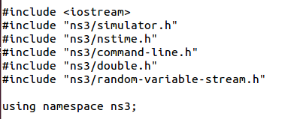
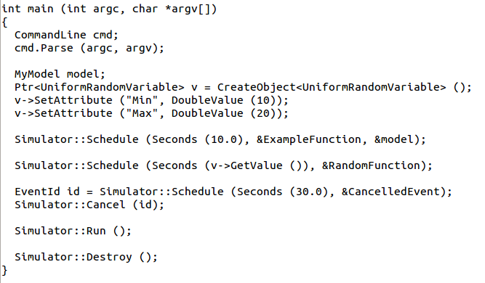
Simulator example

Slide 46
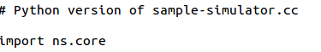
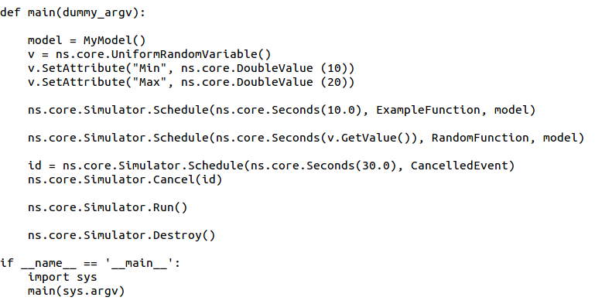
Simulator example (in Python)

Slide 47
Simulation program flow
Handle program inputs
Configure topology
Run simulation
Process outputs

Slide 48
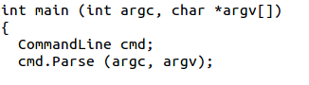
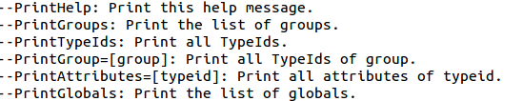
Command-line arguments
Add CommandLine to your program if you want command-line argument parsing
Passing --PrintHelp to programs will display command line options, if CommandLine is enabled
./waf --run "sample-simulator --PrintHelp"

Slide 49
Time in ns-3
Time is stored as a large integer in ns-3
Minimize floating point discrepancies across platforms
Special Time classes are provided to manipulate time (such as standard operators)
Default time resolution is nanoseconds, but can be set to other resolutions
Note: Changing resolution is not well used/tested
Time objects can be set by floating-point values and can export floating-point values
double timeDouble = t.GetSeconds();
Best practice is to avoid floating point conversions where possible

Slide 50
Events in ns-3
Events are just function calls that execute at a simulated time
i.e. callbacks
this is another difference compared to other simulators, which often use special "event handlers" in each model
Events have IDs to allow them to be cancelled or to test their status

Slide 51
Simulator and Schedulers
The Simulator class holds a scheduler, and provides the API to schedule events, start, stop, and cleanup memory
Several scheduler data structures (calendar, heap, list, map) are possible
"RealTime" simulation implementation aligns the simulation time to wall-clock time
two policies (hard and soft limit) available when the simulation and real time diverge

Slide 52
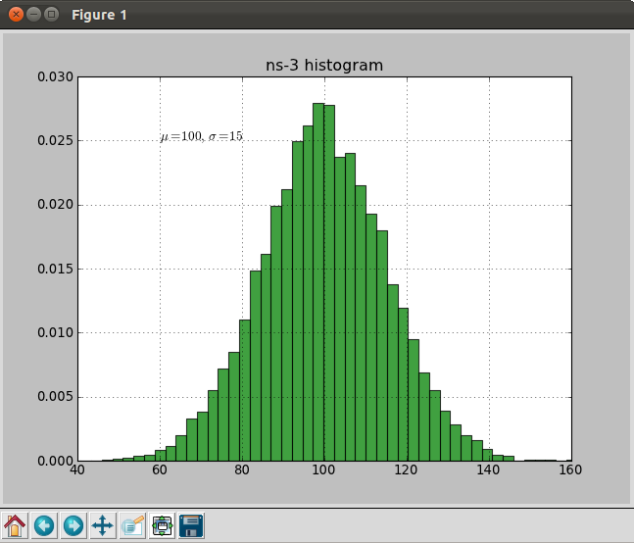
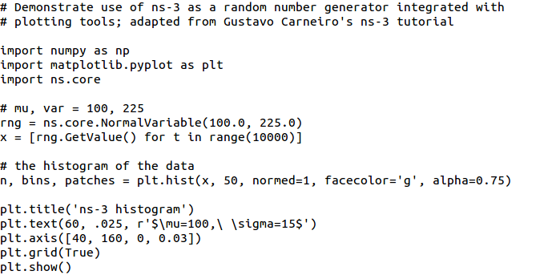
Random Variables
from src/core/examples/sample-rng-plot.py
Currently implemented distributions
Uniform: values uniformly distributed in an interval
Constant: value is always the same (not really random)
Sequential: return a sequential list of predefined values
Exponential: exponential distribution (poisson process)
Normal (gaussian), Log-Normal, Pareto, Weibull, triangular

Slide 53
Random variables and independent replications
Many simulation uses involve running a number of independent replications of the same scenario
In ns-3, this is typically performed by incrementing the simulation run number
not by changing seeds

Slide 54
ns-3 random number generator
Uses the MRG32k3a generator from Pierre L'Ecuyer
http://www.iro.umontreal.ca/~lecuyer/myftp/papers/streams00.pdf
Period of PRNG is 3.1x10^57
Partitions a pseudo-random number generator into uncorrelated streams and substreams
Each RandomVariableStream gets its own stream
This stream partitioned into substreams

Slide 55
Key Terminology
Seed: A set of values that generates an entirely new PRNG sequence
Stream: The PRNG sequence is divided into non-overlapping intervals called streams
Run Number (substream): Each stream is further divided to substreams, indexed by a variable called the run number.

Slide 56
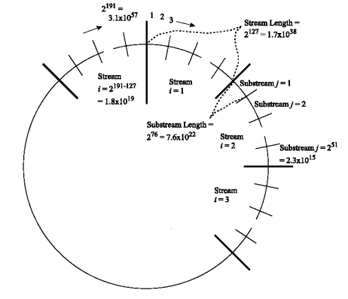
Streams and Substreams
Incrementing the
Run Number will move
all streams to a new
substream
Each ns-3
RandomVariableStream
object is assigned to a
stream (by default,
randomly)
Figure source: Pierre L’Ecuyer, Richard Simard, E. Jack Chen, and W. David Kelton.
An object-oriented random number package with many long streams and substreams. Operations Research, 2001.

Slide 57
Run number vs. seed
If you increment the seed of the PRNG, the streams of random variable objects across different runs are not guaranteed to be uncorrelated
If you fix the seed, but increment the run number, you will get uncorrelated streams

Slide 58
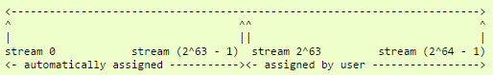
Setting the stream number
The ns-3 implementation provides access to 2^64 streams
2^63 are placed in a pool for automatic assignment, and 2^63 are reserved for fixed assignment
Users may optionally assign a stream number index to a random variable using the SetStream () method.
This allows better control over selected random variables
Many helpers have AssignStreams () methods to do this across many such random variables

Slide 59
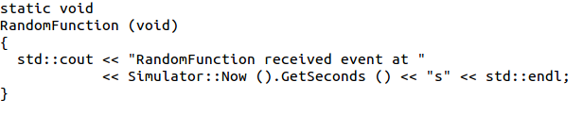
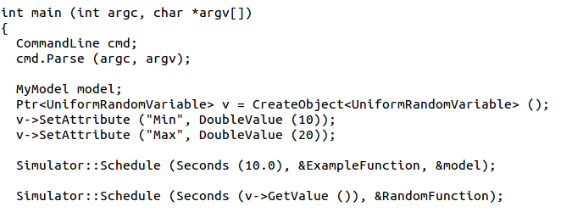
Putting it together
Example of scheduled event
Demo real-time, command-line, random variables...

Slide 60
ns-3 Training

Slide 61
Example walkthrough
This section progressively builds up a simple ns-3 example, explaining concepts along the way
Files for these programs are available on the ns-3 wiki

Slide 62
Example program
wns3-version1.cc
Link found on wiki page
Place program in scratch/ folder

Slide 63
Fundamentals
Key objects in the simulator are Nodes, Packets, and Channels
Nodes contain Applications, “stacks”, and NetDevices

Slide 64
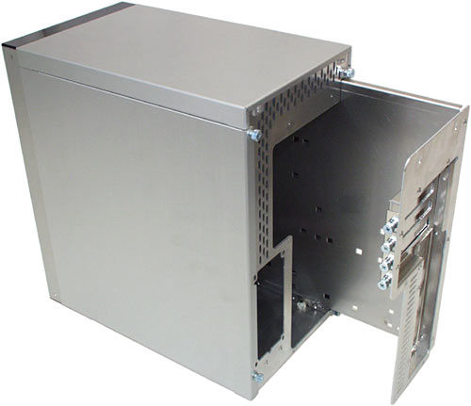


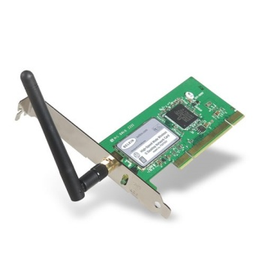
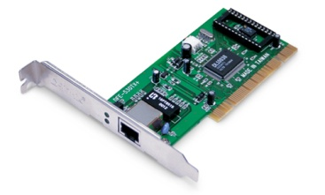
Node basics
A Node is a shell of a computer to which applications, stacks, and NICs are added
Application
Application
Application
“DTN”

Slide 65
NetDevices and Channels
NetDevices are strongly bound to Channels of a matching type
ns-3 Spectrum models relax this assumption
Nodes are architected for multiple interfaces
WifiChannel
WifiNetDevice

Slide 66
Internet Stack
Internet Stack
Provides IPv4 and some IPv6 models currently
No non-IP stacks ns-3 existed until 802.15.4 was introduced in ns-3.20
but no dependency on IP in the devices, Node object, Packet object, etc. (partly due to the object aggregation system)

Slide 67
Other basic models in ns-3
Devices
WiFi, WiMAX, CSMA, Point-to-point, ...
Error models and queues
Applications
echo servers, traffic generator
Mobility models
Packet routing
OLSR, AODV, DSR, DSDV, Static, Nix-Vector, Global (link state)

Slide 68
Structure of an ns-3 program
int main (int argc, char *argv[])
{
// Set default attribute values
// Parse command-line arguments
// Configure the topology; nodes, channels, devices, mobility
// Add (Internet) stack to nodes
// Configure IP addressing and routing
// Add and configure applications
// Configure tracing
// Run simulation
}

Slide 69
Helper API
The ns-3 “helper API” provides a set of classes and methods that make common operations easier than using the low-level API
Consists of:
container objects
helper classes
The helper API is implemented using the low-level API
Users are encouraged to contribute or propose improvements to the ns-3 helper API

Slide 70
Containers
Containers are part of the ns-3 “helper API”
Containers group similar objects, for convenience
They are often implemented using C++ std containers
Container objects also are intended to provide more basic (typical) API

Slide 71
The Helper API (vs. low-level API)
Is not generic
Does not try to allow code reuse
Provides simple 'syntactical sugar' to make simulation scripts look nicer and easier to read for network researchers
Each function applies a single operation on a ''set of same objects”
A typical operation is "Install()"

Slide 72
Helper Objects
NodeContainer: vector of Ptr<Node>
NetDeviceContainer: vector of Ptr<NetDevice>
InternetStackHelper
WifiHelper
MobilityHelper
OlsrHelper
... Each model provides a helper class

Slide 73
Installation onto containers
Installing models into containers, and handling containers, is a key API theme
NodeContainer c;
c.Create (numNodes);
...
mobility.Install (c);
...
internet.Install (c);
...

Slide 74
Native IP models
IPv4 stack with ARP, ICMP, UDP, and TCP
IPv6 with ND, ICMPv6, IPv6 extension headers, TCP, UDP
IPv4 routing: RIPv2, static, global, NixVector, OLSR, AODV, DSR, DSDV
IPv6 routing: RIPng, static

Slide 75
IP address configuration
An Ipv4 (or Ipv6) address helper can assign addresses to devices in a NetDevice container
Ipv4AddressHelper ipv4;
ipv4.SetBase ("10.1.1.0", "255.255.255.0");
csmaInterfaces = ipv4.Assign (csmaDevices);
...
ipv4.NewNetwork (); // bumps network to 10.1.2.0
otherCsmaInterfaces = ipv4.Assign (otherCsmaDevices);

Slide 76
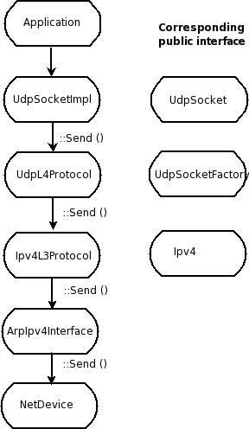
Internet stack
The public interface of
the Internet stack is
defined (abstract base
classes) in
src/network/model
directory
The intent is to support
multiple implementations
The default ns-3 Internet
stack is implemented in
src/internet-stack

Slide 77
ns-3 TCP
Four options exist:
native ns-3 TCP
TCP simulation cradle (NSC)
Direct code execution (Linux/FreeBSD library)
Use of virtual machines
To enable NSC:
internetStack.SetNscStack ("liblinux2.6.26.so");

Slide 78
Native TCP models
TCP NewReno is baseline
TCP SACK under review for ns-3.26
TCP congestion control recently refactored, and many TCP variants are under finalization
Present: BIC, Highspeed, Hybla, Illinois, Scalable, Vegas, Veno, Westwood, YeAH
Pending: CUBIC, H-TCP, SACK
MP-TCP is under development from past summer project (for ns-3.27?)

Slide 79
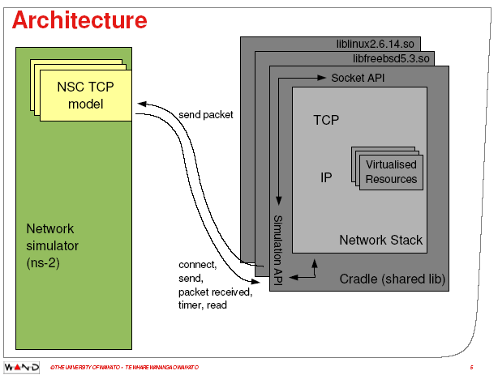
ns-3 simulation cradle
Port by Florian Westphal of Sam Jansen’s Ph.D. work
Figure reference: S. Jansen, Performance, validation and testing with the Network
Simulation Cradle. MASCOTS 2006.

Slide 80
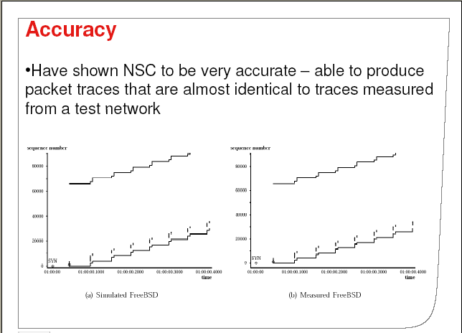
ns-3 simulation cradle
For ns-3:
Linux 2.6.18
Linux 2.6.26
Linux 2.6.28
Others:
FreeBSD 5
lwip 1.3
OpenBSD 3
Other simulators:
ns-2
OmNET++
Figure reference: S. Jansen, Performance, validation and testing with the Network
Simulation Cradle. MASCOTS 2006.

Slide 81
Review of sample program (cont.)
ApplicationContainer apps;
OnOffHelper onoff ("ns3::UdpSocketFactory",
InetSocketAddress ("10.1.2.2", 1025));
onoff.SetAttribute ("OnTime", StringValue ("Constant:1.0"));
onoff.SetAttribute ("OffTime", StringValue ("Constant:0.0"));
apps = onoff.Install (csmaNodes.Get (0));
apps.Start (Seconds (1.0));
apps.Stop (Seconds (4.0));
PacketSinkHelper sink ("ns3::UdpSocketFactory",
InetSocketAddress ("10.1.2.2", 1025));
apps = sink.Install (wifiNodes.Get (1));
apps.Start (Seconds (0.0));
apps.Stop (Seconds (4.0));
Traffic generator
Traffic receiver

Slide 82
Applications and sockets
In general, applications in ns-3 derive from the ns3::Application base class
A list of applications is stored in the ns3::Node
Applications are like processes
Applications make use of a sockets-like API
Application::Start () may call ns3::Socket::SendMsg() at a lower layer

Slide 83
Sockets API
Plain C sockets
int sk;
sk = socket(PF_INET, SOCK_DGRAM, 0);
struct sockaddr_in src;
inet_pton(AF_INET,”0.0.0.0”,&src.sin_addr);
src.sin_port = htons(80);
bind(sk, (struct sockaddr *) &src, sizeof(src));
struct sockaddr_in dest;
inet_pton(AF_INET,”10.0.0.1”,&dest.sin_addr);
dest.sin_port = htons(80);
sendto(sk, ”hello”, 6, 0, (struct sockaddr *) &dest, sizeof(dest));
char buf[6];
recv(sk, buf, 6, 0);
}
ns-3 sockets
Ptr<Socket> sk =
udpFactory->CreateSocket ();
sk->Bind (InetSocketAddress (80));
sk->SendTo (InetSocketAddress (Ipv4Address (”10.0.0.1”), 80), Create<Packet> (”hello”, 6));
sk->SetReceiveCallback (MakeCallback (MySocketReceive));
[…] (Simulator::Run ())
void MySocketReceive (Ptr<Socket> sk, Ptr<Packet> packet)
{
...
}

Slide 84
New in ns-3.25: traffic control
Patterned after Linux traffic control, allows insertion of software-based priority queues between the IP layer and device layer
pfifo_fast, RED, Adaptive RED, CoDel
planned for ns-3.26: FQ-CoDel, PIE, Byte Queue Limits (BQL)

Slide 85
NetDevice trace hooks
Example: CsmaNetDevice
NetDevice::
ReceiveCallback
CsmaNetDevice::Send ()
MacTx
MacRx
MacDrop
queue
Sniffer
PromiscSniffer
MacTxBackoff
PhyTxBegin
PhyRxEnd
PhyRxDrop
PhyTxDrop
PhyTxEnd
CsmaNetDevice::
TransmitStart()
CsmaNetDevice::
Receive()
CsmaChannel

Slide 86
Nodes, Mobility, and Position
ALL nodes have to be created before simulation starts
Position Allocators setup initial position of nodes
List, Grid, Random position…
Mobility models specify how nodes will move
Constant position, constant velocity/acceleration, waypoint…
Trace-file based from mobility tools such as SUMO, BonnMotion (using NS2 format)
Routes Mobility using Google API (*)
(*) Presented in WNS3 - 2015

Slide 87
Position Allocation Examples
List MobilityHelper mobility; // place two nodes at specific positions (100,0) and (0,100) Ptr<ListPositionAllocator> positionAlloc = CreateObject<ListPositionAllocator> (); positionAlloc->Add (Vector (100, 0, 0)); positionAlloc->Add (Vector (0, 100, 0)); mobility.SetPositionAllocator(positionAlloc);
Grid Position
MobilityHelper mobility;
// setup the grid itself: nodes are laid out started from (-100,-100) with 20 per row, the x
// interval between each object is 5 meters and the y interval between each object is 20 meters
mobility.SetPositionAllocator ("ns3::GridPositionAllocator",
"MinX", DoubleValue (-100.0),
"MinY", DoubleValue (-100.0),
"DeltaX", DoubleValue (5.0),
"DeltaY", DoubleValue (20.0),
"GridWidth", UintegerValue (20),
"LayoutType", StringValue ("RowFirst"));
Random Rectangle Position
// place nodes uniformly on a straight line from (0, 1000)
MobilityHelper mobility;
Ptr<RandomRectanglePositionAllocator> positionAloc = CreateObject<RandomRectanglePositionAllocator>();
positionAloc->SetAttribute("X", StringValue("ns3::UniformRandomVariable[Min=0.0|Max=100.0]"));
positionAloc->SetAttribute("Y", StringValue("ns3::ConstantRandomVariable[Constant=50.0]"));
mobility.SetPositionAllocator(positionAloc);

Slide 88
Mobility Model Example
Constant Position
MobilityHelper mobility;
mobility.SetMobilityModel ("ns3::ConstantPositionMobilityModel");
mobility.Install (nodes);
Constant Speed
MobilityHelper mobility;
mobility.SetMobilityModel ("ns3::ConstantVelocityMobilityModel");
mobility.Install (nodes);
Ptr<UniformRandomVariable> rvar = CreateObject<UniformRandomVariable>();
for (NodeContainer::Iterator i = nodes.Begin (); i != nodes.End (); ++i){
Ptr<Node> node = (*i);
double speed = rvar->GetValue(15, 25);
node->GetObject<ConstantVelocityMobilityModel>()->SetVelocity(Vector(speed,0,0));
}
Trace-file based
std::string traceFile = “mobility_trace.txt”;
// Create Ns2MobilityHelper with the specified trace log file as parameter
Ns2MobilityHelper ns2 = Ns2MobilityHelper (traceFile);
ns2.Install (); // configure movements for each node, while reading trace file
Notes:
Explain key differences of these models and under what situations would I use each one.

Slide 89
Interesting ns-3 extensions
ns-3-highway-mobility (https://code.google.com/p/ns-3-highway-mobility/)
Implement IDM and MOBIL change lane, highway class, traffic-lights.
Based on ns-3.8
No longer maintained
Virtual Traffic Lights (PROMELA) (https://dsn.tm.kit.edu/misc_3434.php)
Manhattan IDM mobility model
NLOS propagation loss models
(Virtual) Traffic Light applications

Slide 90
Propagation Models
Propagation Loss
ITUR1411, LogDistance, ThreeLogDistance, Range, TwoRayGround, Friis
Nakagami, Jakes
Obstacle model (*)
Propagation Delay
Constant Speed
Random
Be careful when using YansWifiChannelHelper::Default() the LogDistance propagation model is added. Calling AddPropagationLoss() again will add a second propagation loss model.
(*) Presented in WNS3 2015

Slide 91
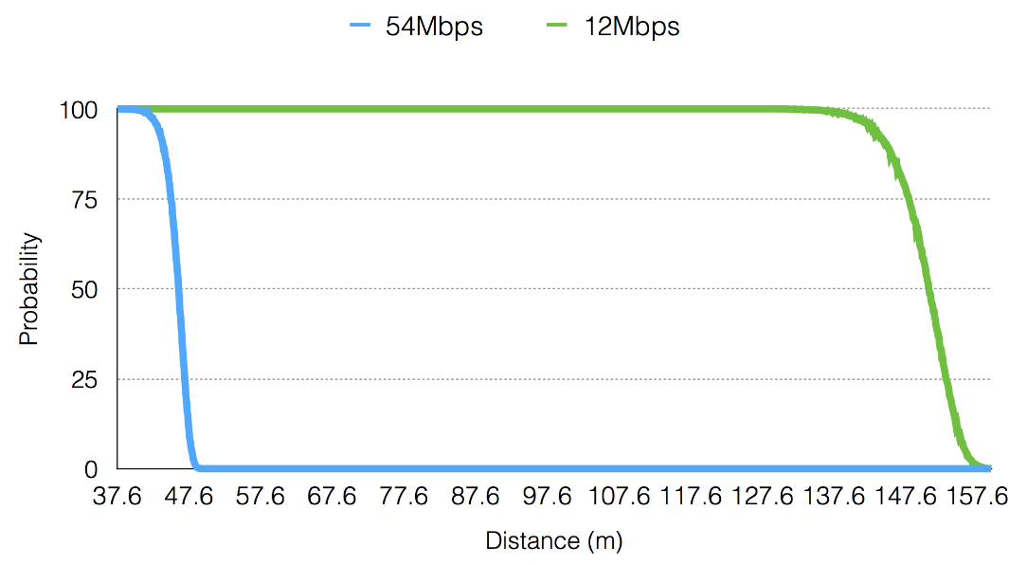
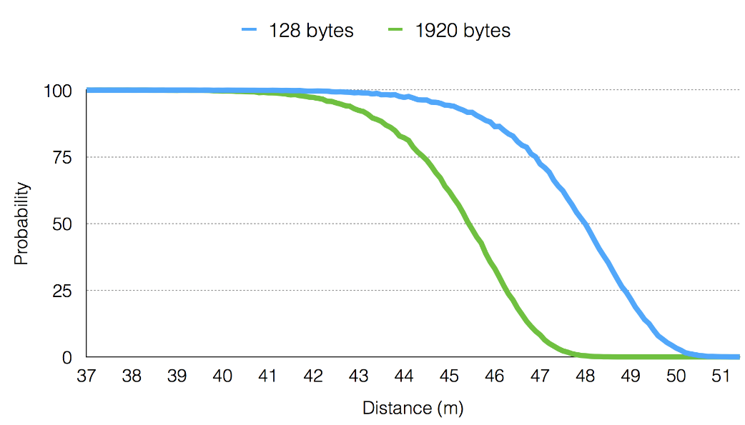
Communication Range
Depends on many factors
Propagation loss model and PHY configuration
Frame size (big vs small)
Transmission mode (6Mbps vs 54 Mbps)

Slide 92
Example program iterations
Walk through four additional revisions of the example program
wns3-version2.cc
wns3-version3.cc
wns3-version4.cc

Slide 93
ns-3 Training: Packets

Slide 94
ns-3 Packet
Packet is an advanced data structure with the following capabilities
Supports fragmentation and reassembly
Supports real or virtual application data
Extensible
Serializable (for emulation)
Supports pretty-printing
Efficient (copy-on-write semantics)

Slide 95
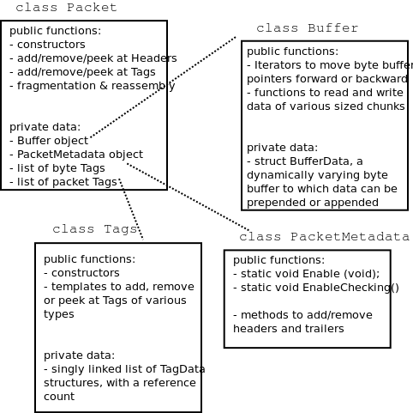
ns-3 Packet structure
Analogous to an mbuf/skbuff

Slide 96
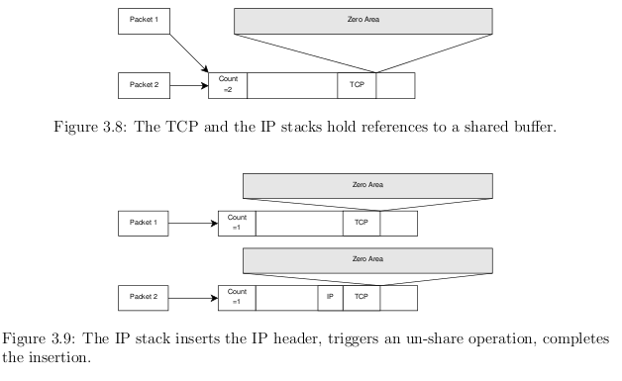
Copy-on-write
Copy data bytes only as needed
Figure source: Mathieu Lacage's Ph.D. thesis

Slide 97
Headers and trailers
Most operations on packet involve adding and removing an ns3::Header
class ns3::Header must implement four methods:
Serialize()
Deserialize()
GetSerializedSize()
Print()

Slide 98
Headers and trailers (cont.)
Headers are serialized into the packet byte buffer with Packet::AddHeader() and removed with Packet::RemoveHeader()
Headers can also be 'Peeked' without removal
Ptr<Packet> pkt = Create<Packet> ();
UdpHeader hdr; // Note: not heap allocated
pkt->AddHeader (hdr);
Ipv4Header iphdr;
pkt->AddHeader (iphdr);

Slide 99
Packet tags
Packet tag objects allow packets to carry around simulator-specific metadata
Such as a "unique ID" for packets or
Tags may associate with byte ranges of data, or with the whole packet
Distinction is important when packets are fragmented and reassembled
Tags presently are not preserved across serialization boundaries (e.g. MPI)

Slide 100
PacketTag vs. ByteTag
Two tag types are available: PacketTag and ByteTag
ByteTags run with bytes
PacketTags run with packets
When Packet is fragmented, both copies of Packet get copies of PacketTags
When two Packets are merged, only the PacketTags of the first are preserved
PacketTags may be removed individually; ByteTags may be removed all at once

Slide 101
Tag example
Here is a simple example illustrating the use of tags from the code in src/internet/model/udp-socket-impl.cc:
Ptr<Packet> p; // pointer to a pre-existing packet
SocketIpTtlTag tag
tag.SetTtl (m_ipMulticastTtl); // Convey the TTL from UDP layer to IP layer
p->AddPacketTag (tag);
This tag is read at the IP layer, then stripped (src/internet/model/ipv4-l3-protocol.cc):
uint8_t ttl = m_defaultTtl;
SocketIpTtlTag tag;
bool found = packet->RemovePacketTag (tag);
if (found)
{
ttl = tag.GetTtl ();
}

Slide 102
Packet metadata
Packets may optionally carry metadata
record every operation on a packet's buffer
implementation of Packet::Print for pretty-printing of the packet
sanity check that when a Header is removed, the Header was actually present to begin with
Not enabled by default, for performance reasons
To enable, insert one or both statements:
Packet::EnablePrinting ();
Packet::EnableChecking ();

Slide 103
Ptr<Packet>
Packets are reference counted objects that support the smart pointer class Ptr
Use a templated "Create" method instead of CreateObject for ns3::Objects
Typical creation:
Ptr<Packet> pkt = Create<Packet> ();
In model code, Packet pointers may be const or non-const; often Packet::Copy() is used to obtain non-const from const
Ptr<const Packet> cpkt = ...;
Ptr<Packet> p = cpkt->Copy ();

Slide 104
ns-3 Training

Slide 105
Object metadata system
ns-3 is, at heart, a C++ object system
ns-3 objects that inherit from base class ns3::Object get several additional features
smart-pointer memory management (Class Ptr)
dynamic run-time object aggregation
an attribute system

Slide 106
Smart pointers
Smart pointers in ns-3 use reference counting to improve memory management
The class ns3::Ptr is semantically similar to a traditional pointer, but the object pointed to will be deleted when all references to the pointer are gone
ns-3 heap-allocated objects should use the templated Create<>() or CreateObject<> () methods

Slide 107
Examples
Ptr<WifiNetDevice> dev =
CreateObject<WifiNetDevice> ();
Ptr<Packet> pkt = Create<Packet> ();
(instead of Packet* = new Packet;)
why Create<> vs CreateObject<>?
two different base classes; generally use CreateObject<>(), but Create<> for Packet

Slide 108
Dynamic run-time object aggregation
This feature is similar to "Component Object Model (COM)"-- allows interfaces (objects) to be aggregated at run-time instead of at compile time
Useful for binding dissimilar objects together without adding pointers to each other in the classes

Slide 109
Usage
ns-3 Node protocol stacks are added via aggregation
The IP stack can be found from a Node pointer without class Node knowing about it
Energy models are typically aggregated to nodes
To find interfaces, use GetObject<>(); e.g.
Ptr<Ipv4> ipv4 = m_node->GetObject<Ipv4> ();

Slide 110
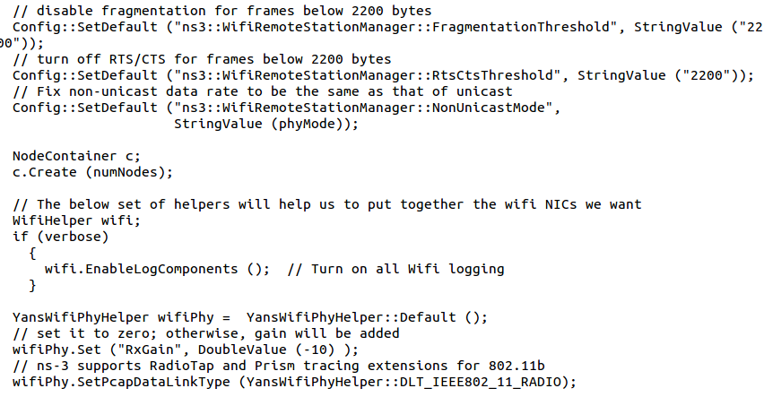
Attributes and default values

Slide 111
ns-3 attribute system
Problem: Researchers want to identify all of the values affecting the results of their simulations
and configure them easily
ns-3 solution: Each ns-3 object has a set of attributes:
A name, help text
A type
An initial value
Control all simulation parameters for static objects
Dump and read them all in configuration files
Visualize them in a GUI
Makes it easy to verify the parameters of a simulation

Slide 112
Short digression: Object metadata system
ns-3 is, at heart, a C++ object system
ns-3 objects that inherit from base class ns3::Object get several additional features
dynamic run-time object aggregation
an attribute system
smart-pointer memory management (Class Ptr)
We focus here on the attribute system

Slide 113
Use cases for attributes
An Attribute represents a value in our system
An Attribute can be connected to an underlying variable or function
e.g. TcpSocket::m_cwnd;
or a trace source

Slide 114
Use cases for attributes (cont.)‏
What would users like to do?
Know what are all the attributes that affect the simulation at run time
Set a default initial value for a variable
Set or get the current value of a variable
Initialize the value of a variable when a constructor is called
The attribute system is a unified way of handling these functions

Slide 115
How to handle attributes
The traditional C++ way:
export attributes as part of a class's public API
walk pointer chains (and iterators, when needed) to find what you need
use static variables for defaults
The attribute system provides a more convenient API to the user to do these things

Slide 116
Navigating the attributes
Attributes are exported into a string-based namespace, with filesystem-like paths
namespace supports regular expressions
Attributes also can be used without the paths
e.g. “ns3::WifiPhy::TxGain”
A Config class allows users to manipulate the attributes

Slide 117
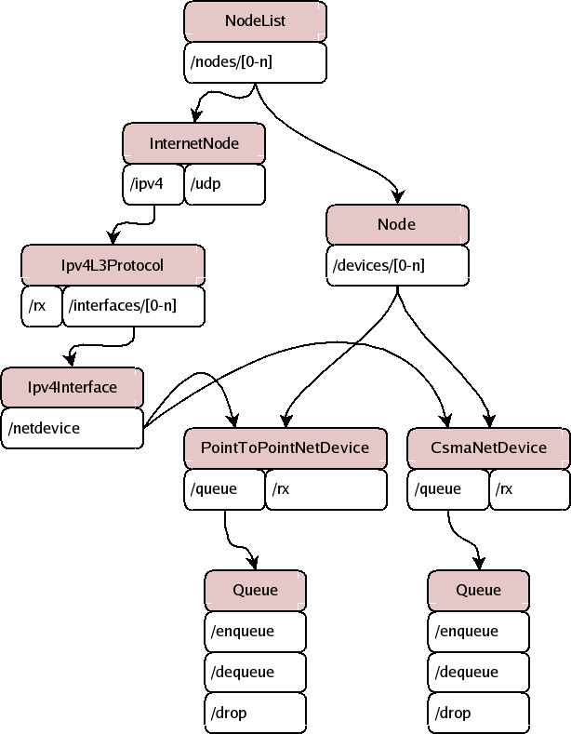
Attribute namespace
strings are used to describe paths through the namespace
Config::Set ("/NodeList/1/$ns3::Ns3NscStack<linux2.6.26>/net.ipv4.tcp_sack", StringValue ("0"));

Slide 118
Navigating the attributes using paths
Examples:
Nodes with NodeIds 1, 3, 4, 5, 8, 9, 10, 11:
“/NodeList/[3-5]|[8-11]|1”
UdpL4Protocol object instance aggregated to matching nodes:
“/$ns3::UdpL4Protocol”

Slide 119
What users will do
e.g.: Set a default initial value for a variable
Config::Set (“ns3::YansWifiPhy::TxGain”, DoubleValue (1.0));
Syntax also supports string values:
Config::Set (“YansWifiPhy::TxGain”, StringValue (“1.0”));
Attribute
Value

Slide 120
Fine-grained attribute handling
Set or get the current value of a variable
Here, one needs the path in the namespace to the right instance of the object
Config::SetAttribute(“/NodeList/5/DeviceList/3/$ns3::WifiNetDevice/Phy/$ns3::YansWifiPhy/TxGain”, DoubleValue(1.0));
DoubleValue d; nodePtr->GetAttribute ( “/NodeList/5/NetDevice/3/$ns3::WifiNetDevice/Phy/$ns3::YansWifiPhy/TxGain”, d);
Users can get Ptrs to instances also, and Ptrs to trace sources, in the same way

Slide 121
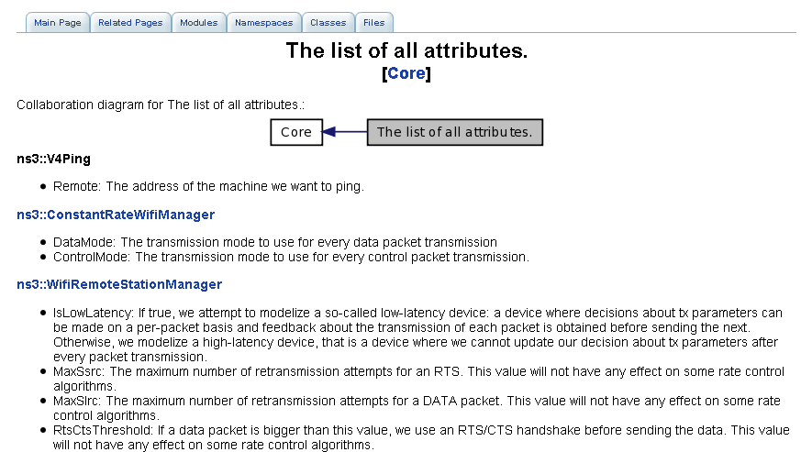
Attribute documentation

Slide 122
Options to manipulate attributes
Individual object attributes often derive from default values
Setting the default value will affect all subsequently created objects
Ability to configure attributes on a per-object basis
Set the default value of an attribute from the command-line:
CommandLine cmd;
cmd.Parse (argc, argv);
Set the default value of an attribute with NS_ATTRIBUTE_DEFAULT
Set the default value of an attribute in C++:
Config::SetDefault ("ns3::Ipv4L3Protocol::CalcChecksum",
BooleanValue (true));
Set an attribute directly on a specic object:
Ptr<CsmaChannel> csmaChannel = ...;
csmaChannel->SetAttribute ("DataRate",
StringValue ("5Mbps"));

Slide 123
Summary on ns-3 objects
ns-3 objects that inherit from base class ns3::Object get several additional features
smart-pointer memory management (Class Ptr)
dynamic run-time object aggregation
an attribute system
These types of objects are allocated on the heap, not on the stack

Slide 124
ns-3 Training

Slide 125
Writing and debugging new programs
Choosing between Python and C++
Reading existing code
Understanding and controlling logging code
Error conditions
Running programs through a debugger

Slide 126
Python bindings
ns-3 uses the 'pybindgen' tool to generate Python bindings for the underlying C++ libraries
Existing bindings are typically found in the bindings/ directory of a module
Some methods are not provided in Python (e.g. hooking trace sources)
Generating new bindings requires a toolchain documented on the ns-3 web site

Slide 127
Debugging support
Assertions: NS_ASSERT (expression);
Aborts the program if expression evaluates to false
Includes source file name and line number
Unconditional Breakpoints: NS_BREAKPOINT ();
Forces an unconditional breakpoint, compiled in
Debug Logging (not to be confused with tracing!)
Purpose
Used to trace code execution logic
For debugging, not to extract results!
Properties
NS_LOG* macros work with C++ IO streams
E.g.: NS_LOG_UNCOND (”I have received ” << p->GetSize () << ” bytes”);
NS_LOG macros evaluate to nothing in optimized builds
When debugging is done, logging does not get in the way of execution performance

Slide 128
Debugging support (cont.)
Logging levels:
NS_LOG_ERROR (...): serious error messages only
NS_LOG_WARN (...): warning messages
NS_LOG_DEBUG (...): rare ad-hoc debug messages
NS_LOG_INFO (...): informational messages (eg. banners)
NS_LOG_FUNCTION (...):function tracing
NS_LOG_PARAM (...): parameters to functions
NS_LOG_LOGIC (...): control flow tracing within functions
Logging ”components”
Logging messages organized by components
Usually one component is one .cc source file
NS_LOG_COMPONENT_DEFINE ("OlsrAgent");
Displaying log messages. Two ways:
Programatically:
LogComponentEnable("OlsrAgent", LOG_LEVEL_ALL);
From the environment:
NS_LOG="OlsrAgent" ./my-program

Slide 129
Running C++ programs through gdb
The gdb debugger can be used directly on binaries in the build directory
An easier way is to use a waf shortcut
./waf --command-template="gdb %s" --run <program-name>

Slide 130
Running C++ programs through valgrind
valgrind memcheck can be used directly on binaries in the build directory
An easier way is to use a waf shortcut
./waf --command-template="valgrind %s" --run <program-name>
Note: disable GTK at configure time when running valgrind (to suppress spurious reports)
./waf configure --disable-gtk --enable-tests ...

Slide 131
Testing
ns-3 models need tests verifiable by others (often overlooked)
Onus is on the simulation project to validate and document results
Onus is also on the researcher to verify results
ns-3 strategies:
regression tests
Aim for event-based rather than trace-based
unit tests for verification
validation of models on testbeds where possible
reuse of code

Slide 132
Test framework
ns-3-dev is checked nightly on multiple platforms
Linux gcc-4.x, i386 and x86_64, OS X, FreeBSD clang, and Cygwin (occasionally)
./test.py will run regression tests
Walk through test code, test terminology (suite, case), and examples of how tests are run

Slide 133
Improving performance
Debug vs optimized builds
./waf -d debug configure
./waf -d debug optimized
Build ns-3 with static libraries
./waf --enable-static
Use different compilers (icc)
has been done in past, not regularly tested

Slide 134
ns-3 Training
Visualization
ns-3 Annual Meeting
June 2016

Slide 135
Overview
No preferred visualizer for ns-3
Several tools have been developed over the years, with some scope limitations
Pyviz
FlowMonitor (statistics with Pyviz linkage)
NetAnim (George Riley and John Abraham)

Slide 136
PyViz overview
Developed by Gustavo Carneiro
Live simulation visualizer (no trace files)
Useful for debugging
mobility model behavior
where are packets being dropped?
Built-in interactive Python console to debug the state of running objects
Works with Python and C++ programs

Slide 137
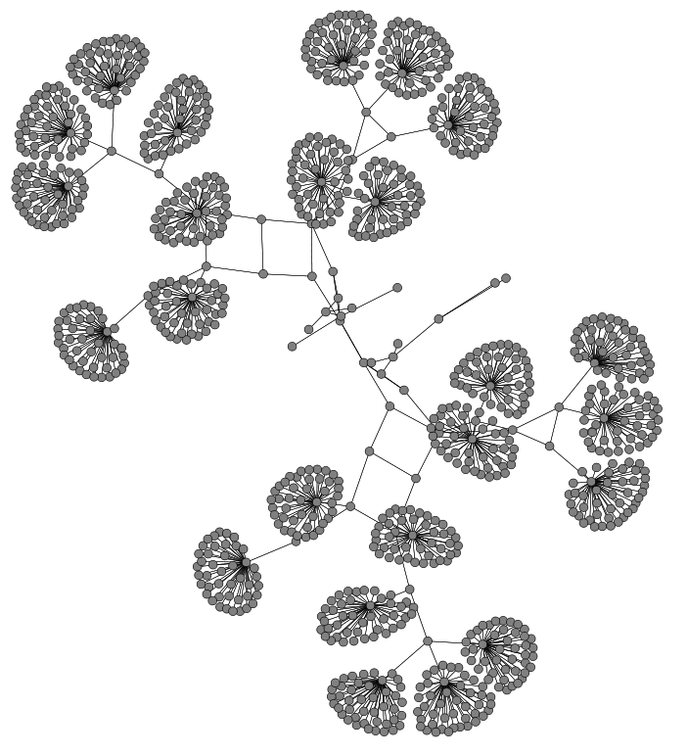
Pyviz screenshot (Graphviz layout)

Slide 138
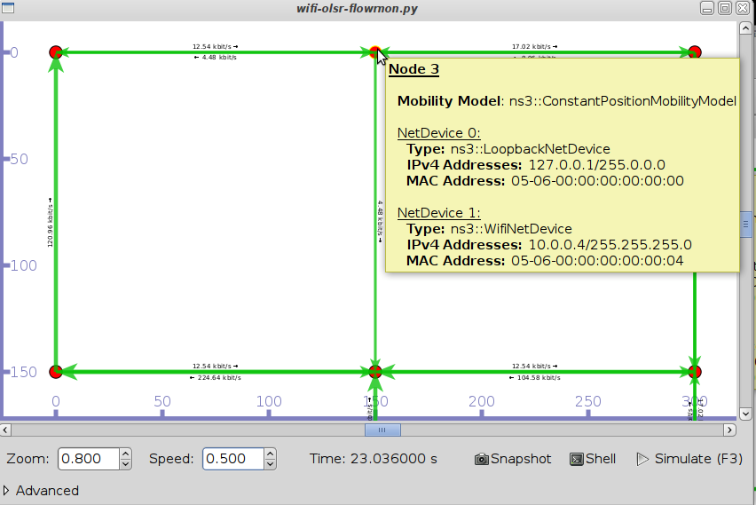
Pyviz and FlowMonitor
src/flow-monitor/examples/wifi-olsr-flowmon.py

Slide 139
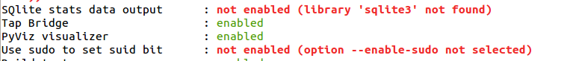
Enabling PyViz in your simulations
Make sure PyViz is enabled in the build
If program supports CommandLine parsing, pass the option
--SimulatorImplementationType=
ns3::VisualSimulatorImpl
Alternatively, pass the "--vis" option

Slide 140
FlowMonitor
Network monitoring framework found in src/flow-monitor/
Goals:
detect all flows passing through network
stores metrics for analysis such as bitrates, duration, delays, packet sizes, packet loss ratios
G. Carneiro, P. Fortuna, M. Ricardo, "FlowMonitor-- a network monitoring framework
for the Network Simulator ns-3," Proceedings of NSTools 2009.

Slide 141
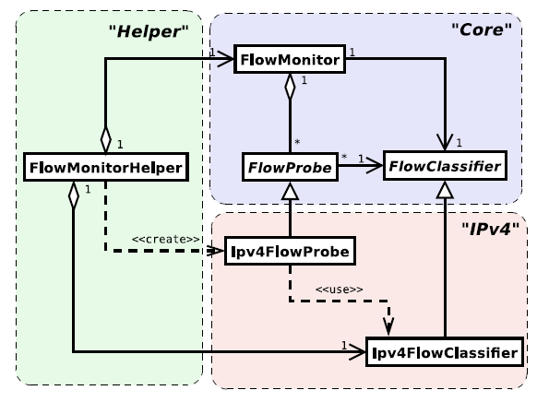
FlowMonitor architecture
Basic classes
FlowMonitor
FlowProbe
FlowClassifier
FlowMonitorHelper
IPv4 and IPv6
Figure credit: G. Carneiro, P. Fortuna, M. Ricardo, "FlowMonitor-- a network monitoring
framework for the Network Simulator ns-3," Proceedings of NSTools 2009.

Slide 142
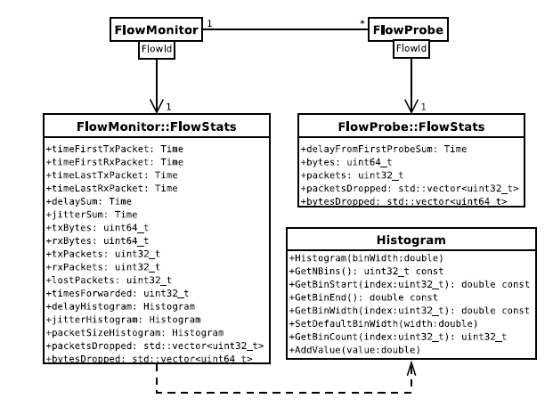
FlowMonitor statistics
Statistics gathered

Slide 143
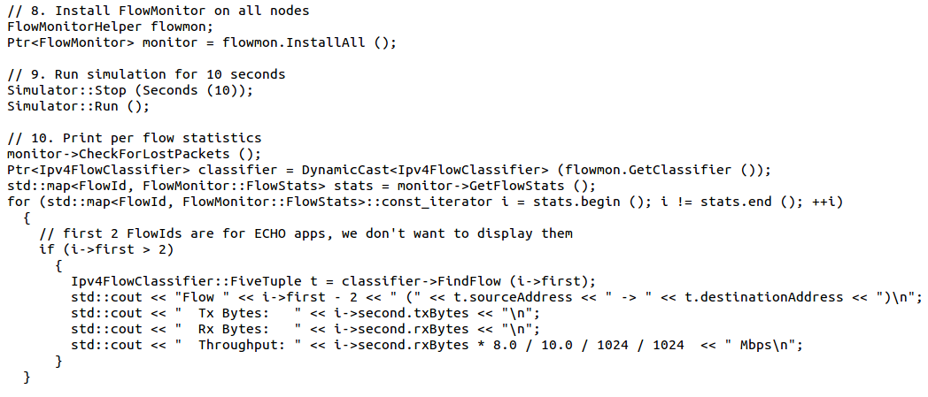
FlowMonitor configuration
example/wireless/wifi-hidden-terminal.cc

Slide 144
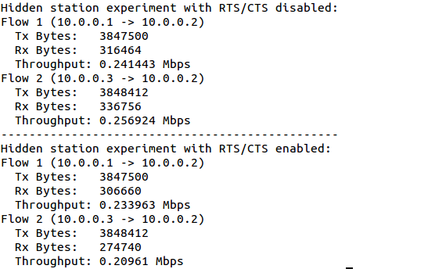
FlowMonitor output
This program exports statistics to stdout
Other examples integrate with PyViz

Slide 145
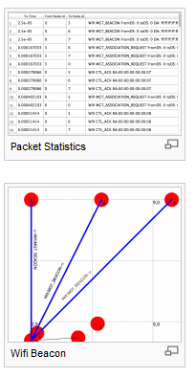
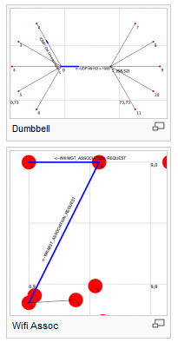
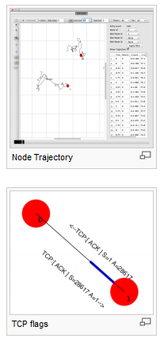
NetAnim
"NetAnim" by George Riley and John Abraham
pyviz

Slide 146
NetAnim key features
Animate packets over wired-links and wireless-links
limited support for LTE traces
Packet timeline with regex filter on packet meta-data.
Node position statistics with node trajectory plotting (path of a mobile node).
Print brief packet-meta data on packets

Slide 147
ns-3 Training

Slide 148
Outline
Emulation modes
Tap Bridge
FdNetDevice
Direct Code Execution (DCE)
Applications
Linux Kernel
DCE Cradle

Slide 149
Emulation support
Support moving between simulation and testbeds or live systems
A real-time scheduler, and support for two modes of emulation
Linux is only operating system supported
Must run simulator in real time
GlobalValue::Bind (“SimulatorImplementationType”, StringValue (“ns3::RealTimeSimulatorImpl”));
Must enable checksum calculations across models
GlobalValue::Bind (“ChecksumEnabled”, BooleanValue (true));
Must run as root

Slide 150
ns-3 emulation modes
real machine
ns-3
ns-3
virtual
machine
virtual
machine
real
machine
real
machine
ns-3
Testbed
1) ns-3 interconnects real or virtual machines
2) testbeds interconnect ns-3 stacks
Various hybrids of the above are possible

Slide 151

Example use case: testbeds
Support for use of Rutgers WINLAB ORBIT radio grid

Slide 152

Example use case: PlanetLab
The PlanetLabFdNetDeviceHelper creates TAP devices on PlanetLab nodes using specific PlanetLab mechanisms (i.e. the vsys system), and associates the TAP device to a FdNetDevice in ns-3.

Slide 153
Example use case: mininet
Mininet is popular in the Software-Defined Networking (SDN) community
Mininet uses "TapBridge" integration
https://github.com/mininet/mininet/wiki/Link-modeling-using-ns-3

Slide 154
Emulation Devices

Slide 155
Device models
File Descriptor Net Device (FdNetDevice)
read and write traffic using a file descriptor provided by the user
this file descriptor can be associated to a TAP device, to a raw socket, to a user space process generating/consuming traffic, etc.
Tap Bridge
Integrate Tun/Tap devices with ns-3 devices

Slide 156
“TapBridge": netns and ns-3 integration
Linux
ns-3
Wifi
ghost node
ghost node
Container
Container
TapBridge
TapBridge
WiFi
WiFi
tapX
tapY
/dev/tunX
/dev/tunY
Tap device pushed into namespaces; no bridging needed

Slide 157
TapBridge modes
ConfigureLocal (default mode)
ns-3 configures the tap device
useful for host to ns-3 interaction
UseLocal
user has responsibility for device creation
ns-3 informed of device using “DeviceName” attribute
UseBridge
TapDevice connected to existing Linux bridge

Slide 158

ConfigureLocal
ns-3 ensures that Mac addresses
are consistent

Slide 159

UseLocal
Mac X spoofed to Mac Y

Slide 160

UseBridge
ns-3 devices must support SendFrom()
(i.e. bridging)

Slide 161
FdNetDevice
Unified handling of reading/writing from file descriptor
Three supported helper configurations:
EmuFdNetDeviceHelper (to associate the ns-3 device with a physical device in the host machine)
TapFdNetDeviceHelper (to associate the ns-3 device with the file descriptor from a tap device in the host machine) (not the same as TapBridge)
PlanetLabFdNetDeviceHelper (to automate the creation of tap devices in PlanetLab nodes, enabling ns-3 simulations that can send and receive traffic though the Internet using PlanetLab resource.

Slide 162

EmuFdNetDeviceHelper
Device performs MAC spoofing to separate emulation from host traffic

Slide 163

PlanetLabFdNetDeviceHelper
Special case of TapFdNetDeviceHelper where Tap devices configured according to PlanetLab conventions

Slide 164
ns-3 over host sockets
Two publications about how to run ns-3 applications over real hosts and sockets
"Simulator-agnostic ns-3 Applications", Abraham and Riley, WNS3 2012
Gustavo Carneiro, Helder Fontes, Manuel Ricardo, "Fast prototyping of network protocols through ns-3 simulation model reuse", Simulation Modelling Practice and Theory (SIMPAT), vol. 19, pp. 2063–2075, 2011.

Slide 165
Generic Emulation Issues
Ease of use
Configuration management and coherence
Information coordination (two sets of state)
e.g. IP/MAC address coordination
Output data exists in two domains
Debugging can be more challenging
Error-free operation (avoidance of misuse)
Synchronization, information sharing, exception handling
Checkpoints for execution bring-up
Inoperative commands within an execution domain
Deal with run-time errors
Soft performance degradation (CPU) and time discontinuities

Slide 166

Tracing in NS-3
DRAFT Version 1
May, 2014
Walid Younes
This work was performed under the auspices of the U.S. Department of Energy by Lawrence Livermore National Security, LLC, Lawrence Livermore National Laboratory under Contract DE-AC52-07NA27344.

Slide 167
Chapter 7: Tracing
Source material:
Online tutorial: http://www.nsnam.org/docs/release/3.14/tutorial/singlehtml/index.html#tracing
T. Predojev (2012): http://wikienergy.cttc.es/images/2/2d/Ns-3-tutorial-complete.pdf
M. Lacage (2009): http://www.nsnam.org/tutorials/ns-3-tutorial-tunis-apr09.pdf
G. Riley (2008): http://www.wns2.org/docs/wns_tutorial-handout.pdf
S. Kristiansen (2010): http://www.uio.no/studier/emner/matnat/ifi/INF5090/v11/undervisningsmateriale/INF5090-NS-3-Tutorial-2011-Oslo-slides.pdf

Slide 168
More advanced tracing with NS3
You can use ascii, pcap tracing or logging to get info from your sim
Need to write code to parse output
The info you want may not be obtainable by pre-defined mechanisms
There is another way in NS3
Add your own traces to events you care about
Produce output in a convenient form
Add hooks to the core that can be accessed by other users later

Slide 169
You could use print statements, but I wouldn’t recommend it
You may have to dig deep inside the NS3 core to find the info you want
More print statements ⇒ need way to enable/disable specific ones
Congratulations! You’ve just re-invented the NS3 logging system!
You could add logging statements to the core
Remember: NS3 is open-source, evolving system
Core will bloat to include all possible log messages
Unwieldy gigantic log files ⇒ effectively useless
No guarantee specific log messages will survive releases
Logging ≠ Tracing

Slide 170
The basic idea: trace sources and sinks
You need:
Trace source: signals sim event and provides access to the data
Trace sink: consumes the trace info, do something useful with it
Mechanism to connect trace source to trace sink
Note: there can be many sinks connected to the same trace source
Trace sink
Trace source
Trace sink
Trace sink

Slide 171
A simple low-level example: callbacks
This is the key to the way tracing works
In C/C++ you can pass a pointer to a function: callback mechanism
Trace source maintains a list of callback functions added by the sinks
When an event of interest happens
Trace source passes data to the callback functions
Callback functions are executed
Ex: a function to integrate functions
float myFunction(float x)
{
return x*x;
}
⋮
float Integrate(float (*func)(float), float lo, float hi)
{
…
}
⋮
Integrate(&myFunction,0,1);

Slide 172
A simple low-level example: fourth.cc
#include "ns3/object.h"
#include "ns3/uinteger.h"
#include "ns3/traced-value.h"
#include "ns3/trace-source-accessor.h"
#include <iostream>
using namespace ns3;
class MyObject : public Object
{
public:
static TypeId GetTypeId (void)
{
static TypeId tid = TypeId ("MyObject")
.SetParent (Object::GetTypeId ())
.AddConstructor<MyObject> ()
.AddTraceSource ("MyInteger",
"An integer value to trace.",
MakeTraceSourceAccessor (&MyObject::m_myInt));
return tid;
}
MyObject () {}
TracedValue<int32_t> m_myInt;
};
void IntTrace (int32_t oldValue, int32_t newValue)
{
std::cout << "Traced " << oldValue << " to " << newValue << std::endl;
}
int main (int argc, char *argv[])
{
Ptr<MyObject> myObject = CreateObject<MyObject> ();
myObject->TraceConnectWithoutContext ("MyInteger", MakeCallback (&IntTrace));
myObject->m_myInt = 1234;
}
Goal: trace changes made to a variable
i.e., notify user whenever
+, ++, =, etc.
Trace source
Trace sink
Connection

Slide 173
A simple-low level example: the trace source
MyObject is derived from Object, inherits public members
class MyObject : public Object
{
public:
static TypeId GetTypeId (void)
{
static TypeId tid = TypeId ("MyObject")
.SetParent (Object::GetTypeId ())
.AddConstructor<MyObject> ()
.AddTraceSource ("MyInteger",
"An integer value to trace.",
MakeTraceSourceAccessor (&MyObject::m_myInt));
return tid;
}
MyObject () {}
TracedValue<int32_t> m_myInt;
};
always need GetTypeId method for an object
provides run-time info on type
allows objects to located via path (more on this later)
provides objects with attributes
provides objects with trace sources

Slide 174
A simple-low level example: the trace source
TypeId class records meta-information about MyObject
class MyObject : public Object
{
public:
static TypeId GetTypeId (void)
{
static TypeId tid = TypeId ("MyObject")
.SetParent (Object::GetTypeId ())
.AddConstructor<MyObject> ()
.AddTraceSource ("MyInteger",
"An integer value to trace.",
MakeTraceSourceAccessor (&MyObject::m_myInt));
return tid;
}
MyObject () {}
TracedValue<int32_t> m_myInt;
};
Provides unique identifier
Record TypeId of base class
Default constructor is accessible
Provides hook to connect to trace source:
Name of source
Help string
Accessor = pointer to connect
Provides infrastructure to
Overload operators
Drive callback process

Slide 175
A simple low-level example: the trace sink
void IntTrace (int32_t oldValue, int32_t newValue)
{
std::cout << "Traced " << oldValue << " to " << newValue << std::endl;
}
A simple void function
Takes in the old and new values of the traced variable
Will be supplied by the trace source
Prints them to the screen

Slide 176
A low-level example: the main function
NS3 smart pointers provide garbage collection via reference counting
Track number of pointers to an object
Helps avoid memory leaks when you forget to delete an object
Wrapper for C++ “new”
int main (int argc, char *argv[])
{
Ptr<MyObject> myObject = CreateObject<MyObject> ();
myObject->TraceConnectWithoutContext ("MyInteger", MakeCallback (&IntTrace));
myObject->m_myInt = 1234;
}
If all goes as planned: should trigger callback
Connecting source to sink
“MyInteger” = name of source
Callback made from our sink function
We’ll talk about “Context” next…

Slide 177
A low-level example: running fourth.cc
cp examples/tutorial/fourth.cc scratch/myfourth.cc
./waf --run scratch/myfourth
Traced 0 to 1234
Assignment in: myObject->m_myInt = 1234;
triggers callback
Seems almost anticlimactic, but we’ve illustrated the main steps in tracing
Define trace source
Define trace sink
Connect trace source to trace sink

Slide 178
Using Config to connect to trace sources
TraceConnectWithoutContext is not typical way to connect source to sink
Normally done via the Config subsystem in ns3, by using a config path
A string that looks like a file path
Represents chain of objects leading to the desired event (or attribute)
We encountered this in third.cc
”/NodeList/7/$ns3::MobilityModel/CourseChange"
Provides a path to the “CourseChange” attribute for node index 7
Let’s dissect this config path

Slide 179
Dissecting the Config path in third.cc
”/NodeList/7/$ns3::MobilityModel/CourseChange"
“NodeList” = predefined namespace in Config, lists all the nodes in the sim
"NodeList/7" = node 7 (i.e., the eigth node)
"$" = what follows designates an aggregated object
Let’s take a short detour to discuss aggregated objects in NS3

Slide 180
Object aggregation in NS3
Makes it possible for objects to access each other, and for users to easily access objects in an aggregation
Avoids need to modify a base class to provide pointers to all possible connected objects
Class definitions would bloat uncontrollably
Solution: separate functionality belongs to separate classes
Node->AggregateObject(mobility);
node
mobility
node
mobility
Retrieving an aggregated object:
Ptr<MobilityModel> mob = node->GetObject<MobilityModel> ();

Slide 181
Dissecting the Config path in third.cc
”/NodeList/7/$ns3::MobilityModel/CourseChange"
“NodeList” = predefined namespace in Config, lists all the nodes in the sim
"NodeList/7" = node 7 (i.e., the eigth node)
"$" = what follows designates an aggregated object
"/NodeList/7/$ns3::MobilityModel" = get the mobility model object aggregated to node 7 in the sim
"CourseChange" = attribute of MobilityModel we are interested in
Config will follow the chain of pointers to the attribute you specified
Config::Connect(”/NodeList/7/$ns3::MobilityModel/CourseChange”,MakeCallback(&CourseChange))
Ties the trace source to the trace sink callback function
Passes the context (= config path) to the callback function

Slide 182
How to Find and Connect Trace Sources, and Discover Callback Signatures
What trace sources are available (besides CourseChange)?
How do I figure out the config path I need to connect to this source?
What are the return type and arguments of my callback function?
void CourseChange(std::string context,Ptr<const MobilityModel> model)
Void IntTrace (int32_t oldValue, int32_t newValue)
Doxygen and a little detective work will go a long way here

Slide 183
What trace sources are available?
Doxygen has the answer!
Trace sources: http://www.nsnam.org/docs/release/3.16/doxygen/group___trace_source_list.html
Attributes: http://www.nsnam.org/docs/release/3.16/doxygen/group___attribute_list.html
Global values: http://www.nsnam.org/docs/release/3.16/doxygen/group___global_value_list.html

Slide 184


What trace sources are available?

Slide 185
What string do I use to connect?
method 1: look for config path in someone else’s code
find -name "*.cc" | xargs grep CourseChange | grep Connect
Config path = "/NodeList/*/$ns3::MobilityModel/CourseChange”
you can use regular expressions in the path, so "*" ⇒ any node
"/NodeList/[3-5]∣8∣[0-1]" would match node indices 0,1,3,4,5,8
⋮
./src/mobility/examples/main-random-walk.cc: Config::Connect ("/NodeList/*/$ns3::MobilityModel/CourseChange",
⋮

Slide 186

What string do I use to connect?
method 2: Doxygen
RandomWalk2dMobilityModel

Slide 187

What string do I use to connect?
method 2: Doxygen
Remember: before, we used:
"NodeList/7/$ns3::MobilityModel/CourseChange"
We’re almost there! We found:
But what’s this bit?
Scroll further down

Slide 188


What string do I use to connect?
method 2: Doxygen
This tells you to access the “CourseChange” attribute from the parent class, so:
"NodeList/7/$ns3::MobilityModel/CourseChange"

Slide 189
What are the return value and arguments for the callback function?
The easy way: copy someone else’s answer
find -name "*.cc" | xargs grep CourseChange | grep Connect
Inside “./src/mobility/examples/main-random-walk.cc”:
And we then find the header of the “CourseChange” function:
./src/mobility/examples/main-random-walk.cc: Config::Connect ("/NodeList/*/$ns3::MobilityModel/CourseChange”,
Config::Connect ("/NodeList/*/$ns3::MobilityModel/CourseChange",
MakeCallback (&CourseChange));
static void CourseChange (std::string foo, Ptr<const MobilityModel> mobility)
But what if you can’t find what you need in someone else’s code?

Slide 190
What return value and arguments for the callback function?
The somewhat easy way
The return value is always “void”
To get the list of formal arguments, look in the ".h" file for the model
Find the "TracedCallback" declaration
For ex,in "src/mobility/model/mobility-model.h”
So for callback using Config::ConnectWithoutContext
And for callback using Config::Connect
TracedCallback<Ptr<const MobilityModel> > m_courseChangeTrace;
This is the argument we need!
void CourseChange(Ptr<const MobilityModel> model)
void CourseChange(std::string path,Ptr<const MobilityModel> model)
Context (= config path) gets passed here

Slide 191
What about TracedValue?
Remember we used the callback function
How did we guess the right formal arguments to use?
Find "TracedCallback" declaration in "src/core/model/traced-value.h”
In fourth.cc, inside the MyObject class, we declared
T = int32_t
Two arguments in the callback, both of type T (i.e., int32_t)
void IntTrace(int32_t oldValue, int32_t newValue)
template <typename T> class TracedValue
{
public:
...
private:
T m_v;
TracedCallback<T,T> m_cb;
};
Template class ⇒ you get to choose its type
TracedValue<int32_t> m_myInt;

Slide 192

A real example
From W. Richard Stevens, “TCP/IP Illustrated, Vol. I: The Protocols”, Addison-Wesley (1994)
Congestion window
Goal: simulate a TCP congestion window and look at the effect of dropped packets

Slide 193
Congestion windows 101 (from Wikipedia)
Congestion collapse occurs at choke points in the network
Wherever total incoming traffic to a node > outgoing bandwidth
e.g., connection points between LAN and WAN
TCP uses network congestion avoidance algorithm
Congestion window is part of TCP strategy to avoid congestion collapse
Limits total number of unacknowledged packets that may be in transit
The size of the window is adjusted dynamically by the sender
Based on how much congestion between sender and receiver
If all segments are received and the acks reach the sender on time
Add a constant to the window (typically 1 MSS = Max Segment Size)
Otherwise
Scale back by a set factor (typically 1/2)
Explains “sawtooth” shape of congestion window over time

Slide 194


Are there trace sources available?
From Doxygen’s "The list of all trace sources"
Look for “congestion”:
We have our trace source:
CongestionWindow
Click on “ns3::TcpNewReno” to access class info

Slide 195

Are there trace sources available?
From Doxygen’s "The list of all trace sources"
Click on link to header file “tcp-newreno.h”
Look for keyword “congestion”

Slide 196

Are there trace sources available?
From Doxygen’s "The list of all trace sources"
TracedValue<uint32_t> m_cWnd; //< Congestion window
this looks a lot like our fourth.cc example
we'll need a callback function of the form
void CwndTrace(uint32_t oldValue,uint32_t newValue)

Slide 197
How do we get started writing our script?
The time-honored way: steal from someone else’s code
find . -name “*.cc” | xargs grep CongestionWindow
Look, e.g., in “./src/test/ns3tcp/ns3tcp-cwnd-test-suite.cc”
The connection between trace and source is done by
We can also copy code from the function
ns3TcpSocket->TraceConnectWithoutContext ("CongestionWindow", MakeCallback (&Ns3TcpCwndTestCase1::CwndChange, this));
This is the callback function
void CwndChange (uint32_t oldCwnd, uint32_t newCwnd)
void Ns3TcpCwndTestCase1::DoRun (void)
This is how fifth.cc was put together

Slide 198
Avoiding a common mistake in NS3
NS3 scripts execute in three separate stages
Configuration time
Simulation time (i.e., Simulator::Run)
Teardown time
TCP uses sockets to connect nodes
Sockets are created dynamically during simulation time
Want to hook the CongestionWindow on the socket of the sender
Connection to trace sources is established during configuration time
Can’t put the cart before the horse!
Solution:
Create socket at configuration time
Hook trace source then
Pass this socket object to system during simulation time
Next: fifth.cc walkthrough

Slide 199
Overview of fifth.cc
Dumbbell topology, point-to-point network, like first.cc
We will create our own application and socket
So we can access socket at configuration time
No helper, so we’ll have to do the work manually
Connect to CongestionWindow trace source in sender socket
Introduce errors into the channel between nodes
Dropped packets ⇒ interesting behavior in congestion window
0
1
Sender
Receiver

Slide 200
Creating our own application: the MyApp class
class MyApp : public Application
{
public:
MyApp ();
virtual ~MyApp();
void Setup (Ptr<Socket> socket, Address address, uint32_t packetSize, uint32_t nPackets, DataRate dataRate);
private:
virtual void StartApplication (void);
virtual void StopApplication (void);
void ScheduleTx (void);
void SendPacket (void);
Ptr<Socket> m_socket;
Address m_peer;
uint32_t m_packetSize;
uint32_t m_nPackets;
DataRate m_dataRate;
EventId m_sendEvent;
bool m_running;
uint32_t m_packetsSent;
};
Initializes member variables
But this is the important bit: we will be able to
Create socket
Hook its CongestionWindow trace source
Pass the socket to the application
All this at configuration time!

Slide 201
Creating our own application: the MyApp class
class MyApp : public Application
{
public:
MyApp ();
virtual ~MyApp();
void Setup (Ptr<Socket> socket, Address address, uint32_t packetSize, uint32_t nPackets, DataRate dataRate);
private:
virtual void StartApplication (void);
virtual void StopApplication (void);
void ScheduleTx (void);
void SendPacket (void);
Ptr<Socket> m_socket;
Address m_peer;
uint32_t m_packetSize;
uint32_t m_nPackets;
DataRate m_dataRate;
EventId m_sendEvent;
bool m_running;
uint32_t m_packetsSent;
};
We also need to override these with our own implementations that will be called by the simulator to start and stop

Slide 202
Creating our own application: the MyApp class
class MyApp : public Application
{
public:
MyApp ();
virtual ~MyApp();
void Setup (Ptr<Socket> socket, Address address, uint32_t packetSize, uint32_t nPackets, DataRate dataRate);
private:
virtual void StartApplication (void);
virtual void StopApplication (void);
void ScheduleTx (void);
void SendPacket (void);
Ptr<Socket> m_socket;
Address m_peer;
uint32_t m_packetSize;
uint32_t m_nPackets;
DataRate m_dataRate;
EventId m_sendEvent;
bool m_running;
uint32_t m_packetsSent;
};
2
1
StartApplication calls SendPacket
SendPacket calls ScheduleTx
ScheduleTx set up next SendPacket call
…
Until StopApplication
3

Slide 203
The trace sinks
We want to trace 2 types of events
Updates to the congestion window:
Dropped packets
static void CwndChange (uint32_t oldCwnd, uint32_t newCwnd)
{
NS_LOG_UNCOND (Simulator::Now ().GetSeconds () << "\t" << newCwnd);
}
static void RxDrop (Ptr<const Packet> p)
{
NS_LOG_UNCOND ("RxDrop at " << Simulator::Now ().GetSeconds ());
}

Slide 204
Introducing errors in the channel
Determines which packets are errored corresponding to underlying
Distribution = random variable
Rate ↔ mean duration between errors
Unit = per-bit, per-byte, or per-packet
Ptr<RateErrorModel> em = CreateObjectWithAttributes<RateErrorModel> (
"RanVar", RandomVariableValue (UniformVariable (0., 1.)),
"ErrorRate", DoubleValue (0.00001));
devices.Get (1)->SetAttribute ("ReceiveErrorModel", PointerValue (em));
Will cause randomly dropped packets in the receiver device

Slide 205
Setting the application on the receiver node
uint16_t sinkPort = 8080;
Address sinkAddress (InetSocketAddress (interfaces.GetAddress (1), sinkPort));
PacketSinkHelper packetSinkHelper ("ns3::TcpSocketFactory", InetSocketAddress (Ipv4Address::GetAny (), sinkPort));
ApplicationContainer sinkApps = packetSinkHelper.Install (nodes.Get (1));
sinkApps.Start (Seconds (0.));
sinkApps.Stop (Seconds (20.));
PacketSink receives and consumes traffic generated to an IP address and port
PacketSinkHelper creates sockets using an “object factory”
Object factories are used to mass produce similarly configured objects
Factory method doesn’t require you to know the type of the objects created

Slide 206
Connecting the sender’s socket, and connecting the trace source
Another way of creating a socket using a socket factory
Ptr<Socket> ns3TcpSocket = Socket::CreateSocket (nodes.Get (0), TcpSocketFactory::GetTypeId ());
ns3TcpSocket->TraceConnectWithoutContext ("CongestionWindow", MakeCallback (&CwndChange));
This should look familiar by now
Because we created our own app and socket at configuration time we can hook into its CongestionWindow trace source

Slide 207
Setting up the application on the sender node
Socket object
Address to connect to
Data per send event
Number of send events
Send data rate
Ptr<MyApp> app = CreateObject<MyApp> ();
app->Setup (ns3TcpSocket, sinkAddress, 1040, 1000, DataRate ("1Mbps"));
nodes.Get (0)->AddApplication (app);
app->SetStartTime (Seconds (1.));
app->SetStopTime (Seconds (20.));

Slide 208
Running fifth.cc: text output
./waf –run scratch/myfifth > cwnd.dat 2>&1
Waf: Entering directory `/mypath/ns-3-dev/build'
Waf: Leaving directory `/mypath/ns-3-dev/build'
'build' finished successfully (1m58.520s)
1 536
1.00919 1072
1.01511 1608
1.02163 2144
1.02995 2680
1.03827 3216
1.04659 3752
1.05491 4288
1.06323 4824
1.07155 5360
1.07987 5896
1.08819 6432
1.09651 6968
1.10483 7504
1.11315 8040
1.12147 8576
1.12979 9112
RxDrop at 1.13692
1.13811 9648
1.15475 2900
1.15563 3436
⋮
Eliminate these lines by hand

Slide 209

Running fifth.cc: plotting the results
Original by W. Richard Stevens
Our result, using gnuplot

Slide 210
That’s nice, but…
Remember after
We had to edit the file by hand to remove “junk” lines…
But we said tracing gives you control over output format
Is there a cleaner way to produce the output we need?
Yes! Use trace helpers
./waf –run scratch/myfifth > cwnd.dat 2>&1
Let’s tweak fifth.cc to produce cleaner output ⇒ sixth.cc

Slide 211
A sixth.cc walkthrough: CwndChange callback
Modify the callback function:
static void CwndChange (Ptr<OutputStreamWrapper> stream, uint32_t oldCwnd, uint32_t newCwnd)
{
NS_LOG_UNCOND (Simulator::Now ().GetSeconds () << "\t" << newCwnd);
*stream->GetStream () << Simulator::Now ().GetSeconds () << "\t" << oldCwnd << "\t" << newCwnd << std::endl;
}
Added to fifth.cc
Formatted output to the stream
Add lines in the main to create stream:
Filename attached to stream
AsciiTraceHelper asciiTraceHelper;
Ptr<OutputStreamWrapper> stream = asciiTraceHelper.CreateFileStream ("sixth.cwnd");
ns3TcpSocket->TraceConnectWithoutContext ("CongestionWindow", MakeBoundCallback (&CwndChange, stream));
Causes the stream argument to be added to the function callback

Slide 212
A sixth.cc walkthrough: RxDrop callback
Modify the callback function:
static void RxDrop (Ptr<PcapFileWrapper> file, Ptr<const Packet> p)
{
NS_LOG_UNCOND ("RxDrop at " << Simulator::Now ().GetSeconds ());
file->Write (Simulator::Now (), p);
}
Added to fifth.cc
Formatted output to the pcap file
Add lines in the main to create stream:
Filename attached to file
PcapHelper pcapHelper;
Ptr<PcapFileWrapper> file = pcapHelper.CreateFile ("sixth.pcap", std::ios::out, PcapHelper::DLT_PPP);
devices.Get (1)->TraceConnectWithoutContext ("PhyRxDrop", MakeBoundCallback (&RxDrop, file));
Causes the file argument to be added to the function callback

Slide 213
Running sixth.cc
1 0 536
1.00919 536 1072
1.01511 1072 1608
1.02163 1608 2144
1.02995 2144 2680
1.03827 2680 3216
1.04659 3216 3752
1.05491 3752 4288
1.06323 4288 4824
1.07155 4824 5360
1.07987 5360 5896
1.08819 5896 6432
1.09651 6432 6968
1.10483 6968 7504
1.11315 7504 8040
1.12147 8040 8576
1.12979 8576 9112
1.13811 9112 9648
⋮
./waf –run scratch/mysixth
sixth.cwnd
Console
Waf: Entering directory `…
Waf: Leaving directory `…
'build' finished successfully (6.002s)
1 536
1.00919 1072
1.01511 1608
1.02163 2144
1.02995 2680
1.03827 3216
1.04659 3752
1.05491 4288
1.06323 4824
1.07155 5360
1.07987 5896
1.08819 6432
1.09651 6968
1.10483 7504
1.11315 8040
1.12147 8576
1.12979 9112
RxDrop at 1.13692
1.13811 9648
1.15475 2900
1.15563 3436
⋮
sixth.pcap
reading from file sixth.pcap, link-type PPP (PPP)
1.136918 IP 10.1.1.1.49153 > 10.1.1.2.8080: Flags [.], seq 17177:17681, ack 1, win 65535, length 504
1.403158 IP 10.1.1.1.49153 > 10.1.1.2.8080: Flags [.], seq 33280:33784, ack 1, win 65535, length 504
1.440505 IP 10.1.1.1.49153 > 10.1.1.2.8080: Flags [.], seq 37440:37944, ack 1, win 65535, length 504
2.525484 IP 10.1.1.1.49153 > 10.1.1.2.8080: Flags [.], seq 173144:173680, ack 1, win 65535, length 536
2.534678 IP 10.1.1.1.49153 > 10.1.1.2.8080: Flags [.], seq 174720:175224, ack 1, win 65535, length 504
2.977574 IP 10.1.1.1.49153 > 10.1.1.2.8080: Flags [.], seq 180552:181088, ack 1, win 65535, length 536
5.796117 IP 10.1.1.1.49153 > 10.1.1.2.8080: Flags [.], seq 582400:582904, ack 1, win 65535, length 504
6.445077 IP 10.1.1.1.49153 > 10.1.1.2.8080: Flags [.], seq 663520:664024, ack 1, win 65535, length 504
7.359404 IP 10.1.1.1.49153 > 10.1.1.2.8080: Flags [.], seq 777384:777920, ack 1, win 65535, length 536
7.389304 IP 10.1.1.1.49153 > 10.1.1.2.8080: Flags [.], seq 781040:781544, ack 1, win 65535, length 504
8.141483 IP 10.1.1.1.49153 > 10.1.1.2.8080: Flags [.], seq 875144:875680, ack 1, win 65535, length 536

Slide 214
Just for fun: what happens to uncorrupted packets?
PhyRxEnd: Trace source indicating a packet has been completely received by the device

Slide 215
Using trace helpers
We’ve encountered trace helpers before
What other trace helpers are available?
How do we use them?
What do they have in common?
pointToPoint.EnablePcapAll ("second");
pointToPoint.EnablePcap ("second", p2pNodes.Get (0)->GetId (), 0);
csma.EnablePcap ("third", csmaDevices.Get (0), true);
pointToPoint.EnableAsciiAll (ascii.CreateFileStream ("myfirst.tr"));

Slide 216
Two categories of trace helpers
Device helpers
Trace is enabled for node/device pair(s)
Both pcap and ascii traces provided
Conventional filenames: <prefix>-<node id>-<device id>
Protocol helpers
Trace is enabled for protocol/interface pair(s)
Both pcap and ascii traces provided
Conventional filenames: <prefix>-n<node id>-i<interface id>
“n” and “i” to avoid filename collisions with node/device traces

Slide 217
NS3 uses “mixin” classes to ensure tracing works the same way across all devices or interfaces
Mixin classes in NS3 (see Doxygen for more info):
These mixin classes each provide a single virtual method to enable trace
All device or protocols must implement this method
All other methods of the mixin class call this one method
Provides consistent functionality across different devices & interfaces
 | PCAP | ASCII
Device Helper | PcapHelperForDevice | AsciiTraceHelperForDevice
Protocol Helper | PcapHelperForIpv4 | AsciiTraceHelperForIpv4

Slide 218
The PcapHelperForDevice mixin class
Every device must implement
All other methods of PcapHelperForDevice call this one
Pcap filename prefix
virtual void EnablePcapInternal (std::string prefix,
Ptr<NetDevice> nd,
bool promiscuous,
bool explicitFilename) = 0;
Device to trace
Type of trace
Override prefix
⇒ Consistency across devices

Slide 219
Pcap Tracing Device Helper: EnablePcap methods
EnablePcap for various node/device pair(s)
Provide Ptr<NetDevice>
Provide device name using the NS3 object name service
Provide a NetDeviceContainer
Provide a NodeContainer
Provide integer node and device ids
Enable pcap tracing for all devices in the simulation
Names::Add ("server" ...);
Names::Add ("server/eth0" ...);
...
helper.EnablePcap ("prefix", "server/ath0");
helper.EnablePcapAll ("prefix");

Slide 220
Pcap Tracing Device Helper: filename selection
By convention: <prefix>-<node id>-<device id>.pcap
Can use the NS3 object name service to replace ids with meaningful names e.g.,
You can override the naming convention, e.g.
prefix-21-1.pcap
Names::Add(“server”,serverNode);
Names::Add(“server/eth0”,serverDevice);
prefix-server-eth0.pcap
void EnablePcap(std::string prefix, Ptr<NetDevice> nd, bool promiscuous, bool explicitFilename);
Set this to true
prefix becomes filename

Slide 221
Ascii Tracing Device Helpers
The mixin class is AsciiTraceHelperForDevice
All device implement virtual EnableAsciiInternal method
All other methods of AsciiTraceHelperForDevice will call this one
Can provide EnableAscii with Ptr<NetDevice>, string from name service, NetDeviceContainer, NodeContainer, integer node/device ids
Or helper.EnableAsciiAll(“prefix”);
Can also dump ascii traces to a single common file, e.g.,
So there are twice as many trace methods as for pcap
Ptr<NetDevice> nd1;
Ptr<NetDevice> nd2;
...
Ptr<OutputStreamWrapper> stream = asciiTraceHelper.CreateFileStream ("trace-file-name.tr");
...
helper.EnableAscii (stream, nd1);
helper.EnableAscii (stream, nd2);

Slide 222
Ascii Tracing Device Helpers: filename selection
By convention: <prefix>-<node id>-<device id>.tr
Using NS3 object name service, can assign names to the id, then e.g.
"prefix-21-1.tr” → "prefix-server-eth0.tr”
Many EnableAscii methods offer a explicitFilename option
set to true ⇒ override naming convention, use your own file name

Slide 223
Pcap Tracing Protocol Helpers
The mixin class is PcapHelperForIpv4
All device implement virtual EnablePcapIpv4Internal method
All other methods of PcapHelperForIpv4 will call this one
Can provide EnablePcapIpv4 with Ptr<Ipv4>, string from name service, Ipv4InterfaceContainer, NodeContainer, integer node/device ids
Or helper.EnablePcapIpv4All(“prefix”);
Filename selection
Convention is <prefix>-n<node id>-i<interface id>.pcap
Can also use the NS3 object name service clarity
explicitFilename parameter lets you impose your own filenames

Slide 224
Ascii Tracing Protocol Helpers
The mixin class is AsciiTraceHelperForIpv4
All device implement virtual EnableAsciiIpv4Internal method
All other methods of AsciiTraceHelperForIpv4 will call this one
Can provide EnableAsciiIpv4 with Ptr<Ipv4>, string from name service, Ipv4InterfaceContainer, NodeContainer, integer node/device ids
Or helper.EnableAsciiIpv4All(“prefix”);
Can also dump ascii traces to a single common file
So there are twice as many trace methods as for pcap
Filename selection
Convention is <prefix>-n<node id>-i<interface id>.pcap
Can also use the NS3 object name service clarity
explicitFilename parameter lets you impose your own filenames

Slide 225
Conclusion
NS3 is very powerful/comprehensive
Lots of tools for you to use
Helpers
Containers
Logging
Tracing
Models
Doxygen is your friend!
Practice! Practice! Practice!

